Slide 1


Role of TIMP-1 and MMP-13 in Equine Mesenchymal Stem Cells: Advancing Osteoarthritis Therapy in Racehorses
Anita Czacharowska, Dr Emily J Clarke, Prof Mandy Peffers
Notes:
TIMP1
Tissue Inhibitor of Metalloproteinases-1
MMP13
Matrix Metalloproteinase-13

Slide 2

Definitions
MMP13: Matrix Metalloproteinase-13
  Enzyme that breakdowns cartilage
  Degrades collagen
  Key target in osteoarthritis progression (1)
TIMP1: Tissue Inhibitor of Metalloproteinase-1
  Cytokine like function
  Regulating cell growth
  Controls differentiation
  Supresses apoptosis (2)

Slide 3


Musculoskeletal Injury in Equine Athlete
Racehorses are predisposed to musculoskeletal injury
  82% of horse injuries in National Hunt and flat race were musculoskeletal (3)
Osteoarthritis causes 60% of all lameness in horses (4)
  High impact exercises can lead to
  depletion of proteoglycans (5)
Welfare concern and leading reason for euthanasia in geriatric horses (24%) (6)
Figure 1: Percentage of horse lameness cased by osteoarthritis
Notes:
Racehorses are worked from a young age with high impact exercises meaning they are more at risk of depletion of proteoglycans and therefore more predisposed to injury in the joint area
Cartilage has limited healing and self-repair due to the lack of blood vessels and lymphatics as well as limited chondrocyte replication, therefore injuries can easily develop into osteoarthritis
It is a painful condition and a leading cause of euthanasia in geriatric horses and of retirement in racing horses

Slide 4
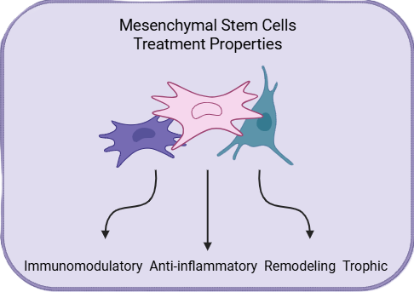
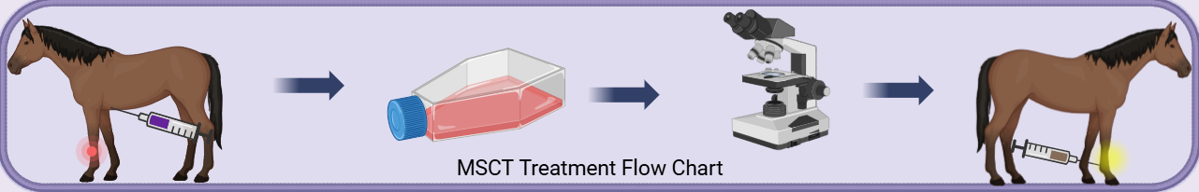
Mesenchymal Stem Cell Therapy
MSC are harvested from bone marrow/adipose tissue, injected at site of injury, and can self replicate and differentiate to help aid in repair and regeneration
Can be allogenic or autogenic
Supported by literature to promote cartilage regeneration by reducing joint inflammation (7)
Clinical Studies Show:
  Improvement in clinical signs in horses with musculoskeletal injury
  Reduction in progression of disease (8)
Figure 2: Summary of properties of MSCs
Figure 3: Autogenic MSCT Treatment flow chart

Slide 5
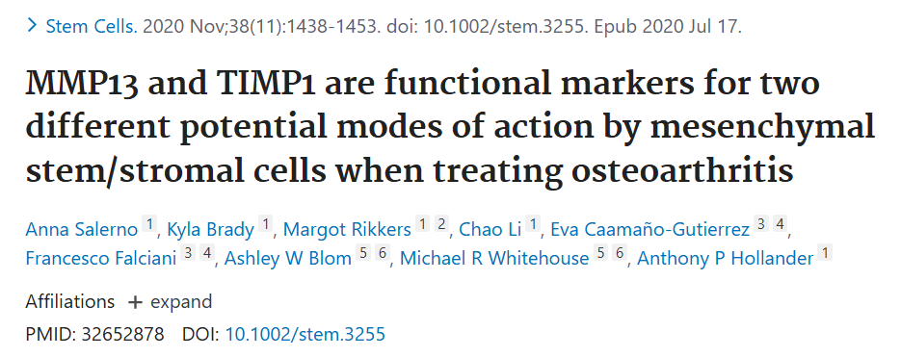
Human Study
Early passage MMP13+, TIMP1 secreting MSCs should be used for autologous OA therapies designed to act through engraftment and chondrogenesis
Later passage MMP13−, TIMP1 secreting MSCs could be exploited for allogeneic OA therapies designed to act through trophic repair. (9)
TIMP1= Tissue Inhibitor of Metalloproteinase-1
MMP13= Matrix Metalloproteinase-13
Notes:
TIMP1
Tissue Inhibitor of Metalloproteinases-1
It is a protein that performs two main functions:
Inhibits matrix metalloproteinases (MMPs), which are enzymes that break down the extracellular matrix.
Acts as a cytokine, regulating cell functions like proliferation (cell growth), anti-apoptosis (preventing cell death), and differentiation.
MMP13
Matrix Metalloproteinase-13
is an enzyme in the matrix metalloproteinase (MMP) family that degrades extracellular matrix (ECM) proteins, particularly collagen, and is involved in tissue remodeling, inflammation, and cell processes
MMP13 would allow good for autologous chondrogenesis because a bit of collagen-degrading activity helps cells engraft and remodel tissue
Trophic repair= Trophic repair refers to tissue repair mediated indirectly by the secretome of MSCs rather than by MSCs turning into new tissue (engraftment).
MSCs release paracrine factors (growth factors, cytokines, extracellular vesicles, exosomes) that:
Reduce inflammation (e.g., IL-10, TSG-6).
Inhibit cell death in chondrocytes.
Stimulate host cells (like resident chondrocytes and progenitors) to proliferate and produce matrix.
Modulate immune cells (shift macrophages toward anti-inflammatory M2 phenotype

Slide 6
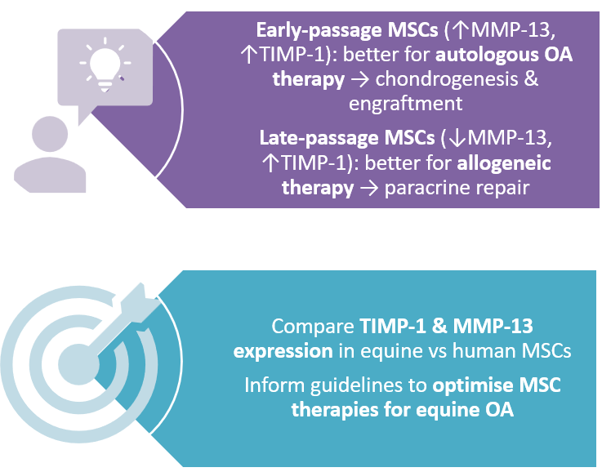
Hypothesis and Study Aims
Hypothesis:
Study Aims:
Early-passage MSCs (↑MMP-13, ↑TIMP-1): better for autologous OA therapy → chondrogenesis & engraftment
Late-passage MSCs (↓MMP-13, ↑TIMP-1): better for allogeneic therapy → paracrine repair
Compare TIMP-1 & MMP-13 expression in equine vs human MSCs
Inform guidelines to optimise MSC therapies for equine OA

Slide 7
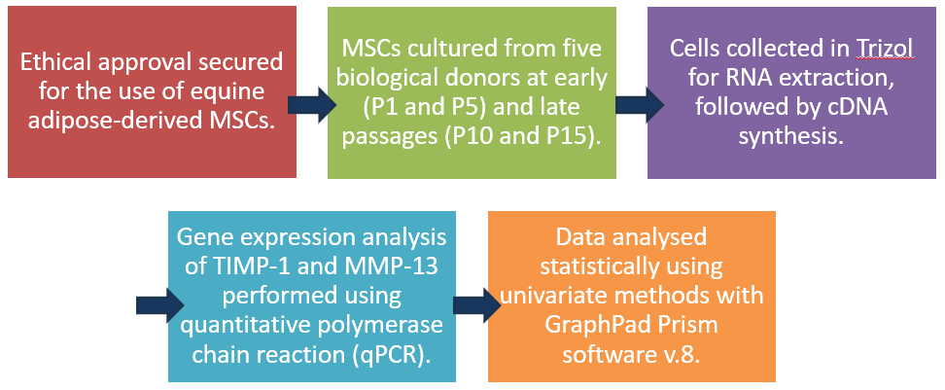

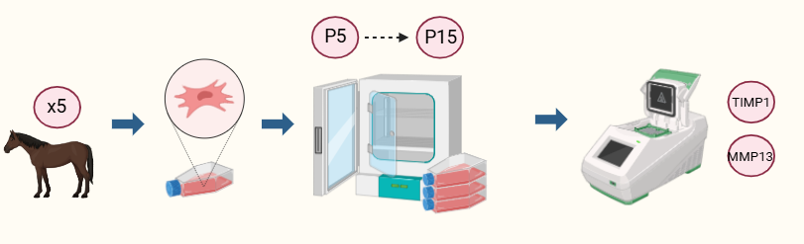
Methods
Ethical approval secured for the use of equine adipose-derived MSCs.
MSCs cultured from five biological donors at early (P1 and P5) and late passages (P10 and P15).
Cells collected in Trizol for RNA extraction, followed by cDNA synthesis.
Gene expression analysis of TIMP-1 and MMP-13 performed using quantitative polymerase chain reaction (qPCR).
Data analysed statistically using univariate methods with GraphPad Prism software v.8.
Figure 4: Summary of research process
Notes:
MSC Sourced from similar group of horses: Adipose tissue, middle aged, thoroughbred
Compared to human sample: four donors.

Slide 8
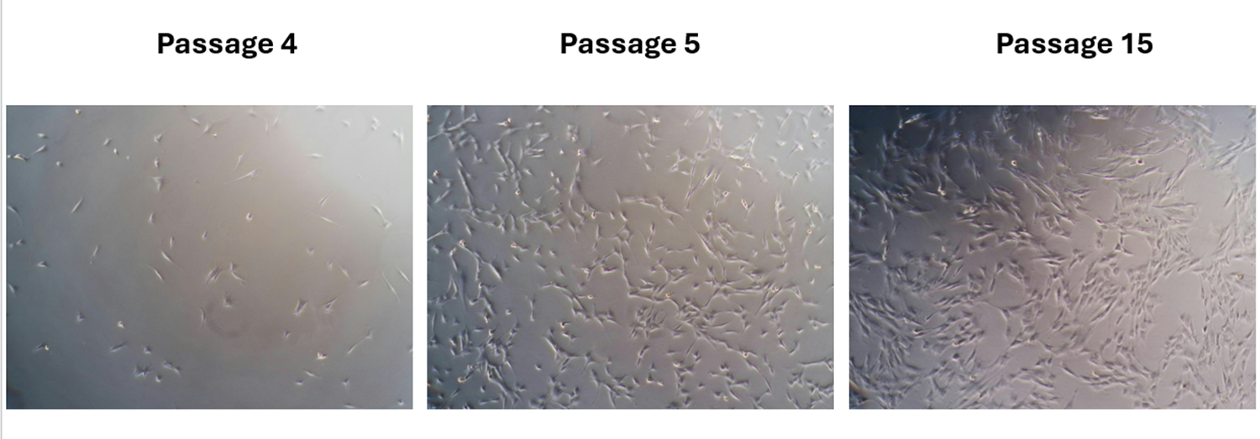
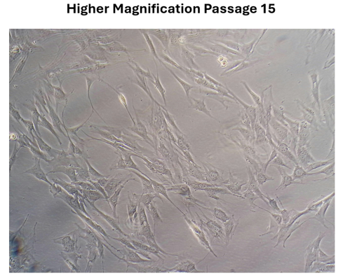
Cells Across Different Passages
Figure 5: Microscope Images of mesenchymal stem cells at different passages from donor ASC1. Passage 4, 5, 15 on top is at magnification x10. Passage 15 on the bottom is at magnification x40
Notes:
Cell morphology changed to more spindle-shaped

Slide 9
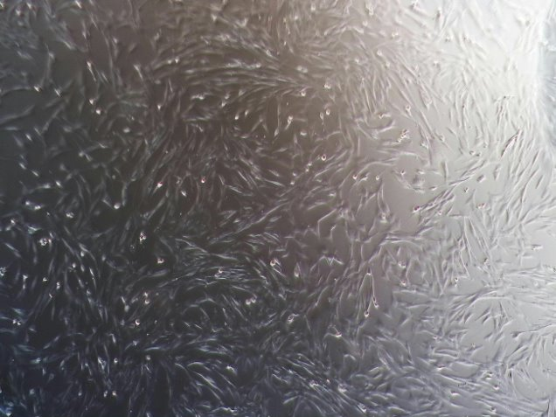
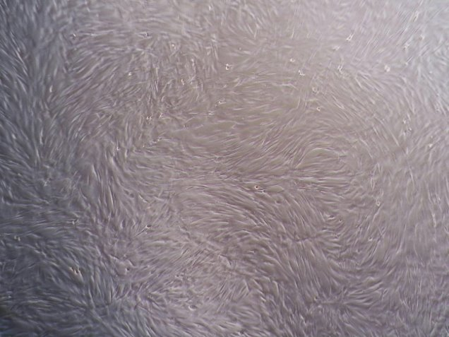
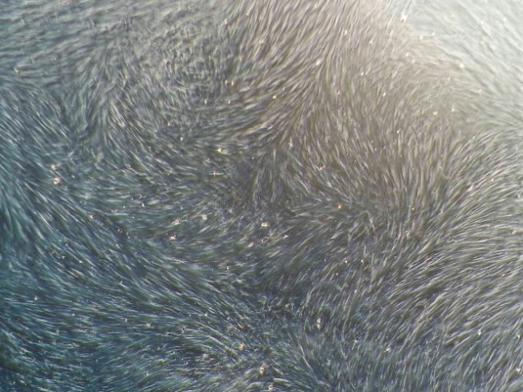
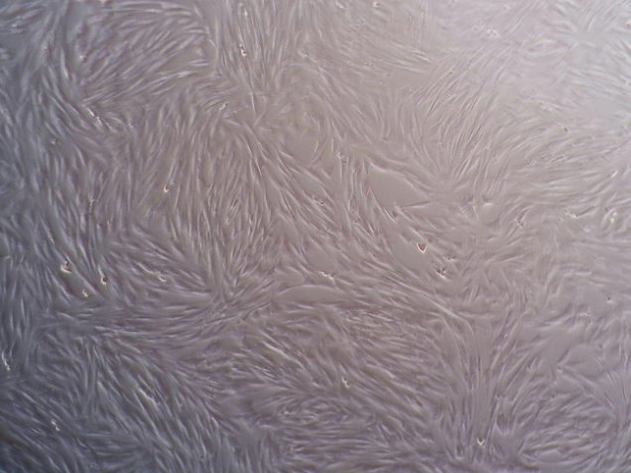
Cells Across Different Passages
Passage 5 Passage 15
Figure 6: Microscope Images of mesenchymal stem cells at different passages from donor ASC11 (top) and ASC13 (bottom). Passage 5, 15 is at magnification x10.
Passage 5 Passage 15
Notes:
Cell morphology remained consistent for the other donors
Studies showed that with further passage the MSC can become more flat like and less spindle shaped. Coincide with senescence.
Our cell appeared to retain their stemness
Sources:
“Progressive shortening of the telomeres …have been proposed to be the
main trigger for replicative senescence, and it has been
anticipated that telomere shortening provides an internal
clock—with every cell division the number of telomere
repeats decreases.” 19–21
“It is, however, still
controversially discussed if telomere shortening is really the
initiating mechanism for replicative senescence or if it is
rather effected by this process.
16,22–24”
Alternatively, it has
https://www.researchgate.net/publication/41668471_Different_Facets_of_Aging_in_Human_Mesenchymal_Stem_Cells
“show that during in vitro expansion, MSCs lose their spindle morphology and become large and flat”
https://journals.biologists.com/bio/article/8/4/bio039453/1891/Soft-substrate-maintains-proliferative-and

Slide 10
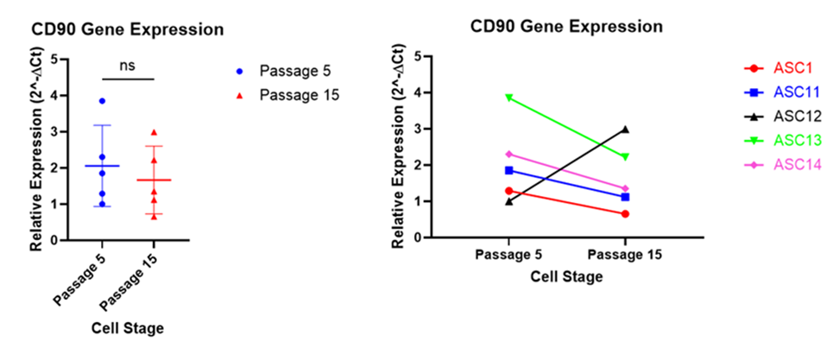
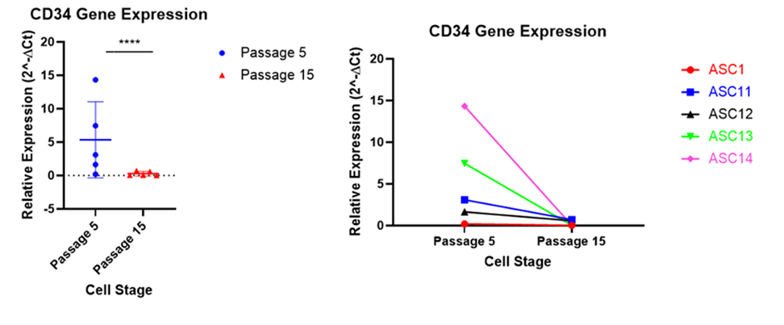
Results
Gene Expression of CD90 and CD34
Figure 7: Gene expression of CD90 according to passage, using qPCR. T-test performed
Figure 8: Gene expression of CD34 according to passage, using qPCR. T- test performed
Significance is denoted by *(p<0.05), ** (p<0.01), *** (p< 0.001), **** (p<0.0001).
Notes:
CD90= Mesenchymal stem cell marker
CD34= hematopoietic stem cell markers CD34
Unpaired t-test showing significance
CD90 dropped insignificantly
CD34 decreased significantly
Explain results in next slide…

Slide 11
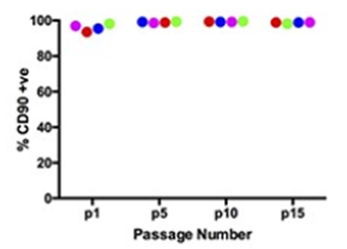

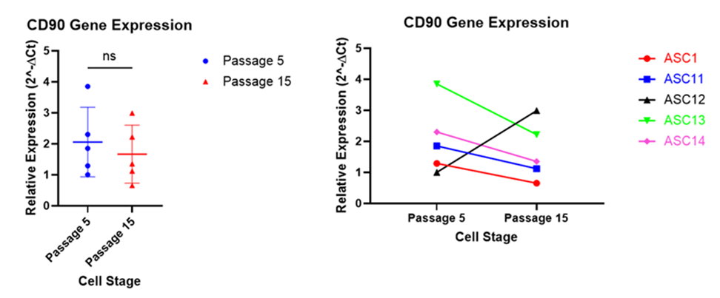

Results
Gene expression CD90 comparison to Human Study
Human Study: protective and reparative effects of MSCs are a fundamental feature of CD105+ve, CD90+ve, CD34−ve, CD45−ve MSCs, that is retained even after extensive expansion in vitro. (9)
Equine Study:
Confirms CD90 remains high after expansion (expression decreased a non-significant amount). Slight loss of stemness.
Figure 9 : Percentage of cells expressing MSC marker CD90 determined by fluorescence-activated cell sorting. Figure adapted from Salerno et al., 2020
Figure 10: Gene expression of CD90 according to passage, using qPCR. T-test performed

Slide 12
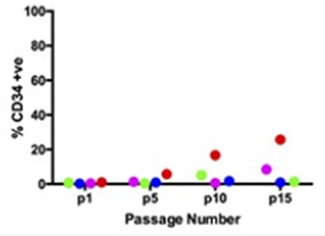

Results
Gene expression CD34 comparison to Human Study
Human Study: protective and reparative effects of MSCs are a fundamental feature of CD105+ve, CD90+ve, CD34−ve, CD45−ve MSCs, that is retained even after extensive expansion in vitro.
Equine Study:
CD34 Gene expression decreased with further passage.
MSCs freshly derived from adipose tissue have been shown in other studies to express CD34. (10)
Figure 11: percentage of cells expressing hematopoietic stem cell marker CD34 determined by fluorescence-activated cell sorting. Figure adapted from Salerno et al., 2020
Figure 12: Gene expression of CD34 according to passage, using qPCR. T-test performed
Notes:
CD34= Marker for hematopoietic stem cells

Slide 13
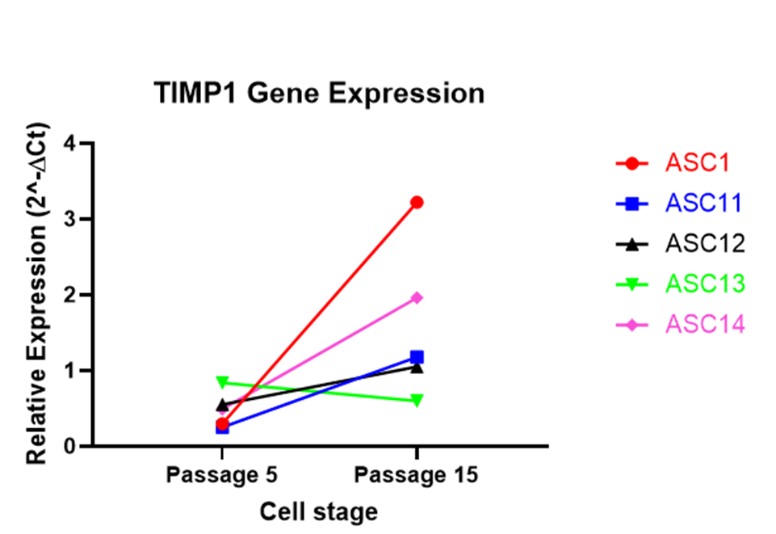
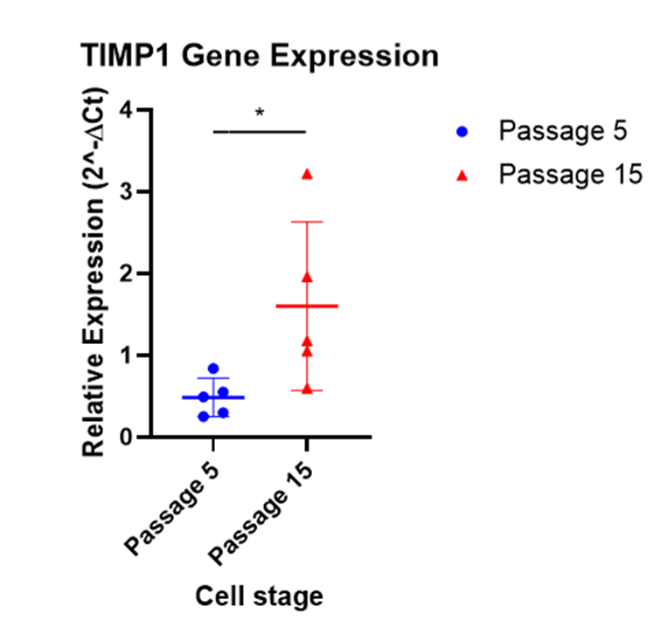
Results
Gene expression of TIMP1
Figure 13: Gene expression of TIMP1 according to passage using qPCR. T-test performed
Significance is denoted by *(p<0.05), ** (p<0.01), *** (p< 0.001), **** (p<0.0001).
Notes:
TIMP1 increased with passage

Slide 14
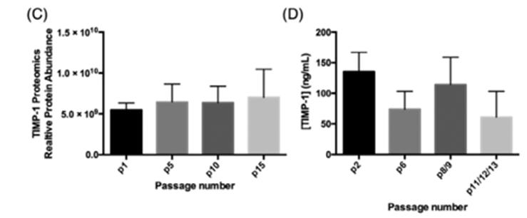



Results
Gene expression TIMP1 comparison to Human Study
Figure 14 : Gene expression of TIMP1 according to passage using protein expression. Figure adapted from Salerno et al., 2020
Figure 15 : Gene expression of TIMP1 according to passage using enzyme linked immunosorbent assay analysis. Figure adapted from Salerno et al., 2020
Figure 16: Gene expression of TIMP1 according to passage using qPCR. T-test performed
TIMP1 levels remained high in humans (protein expression, ELISA)
TIMP1 levels in horses increased with passage (PCR)
Notes:
Gene expression changes in TIMP1 like human protein expression of timp 1- next step is; does timp1 protein expression show some trend as gene expression
TIMP1 high - act through trophic repair

Slide 15
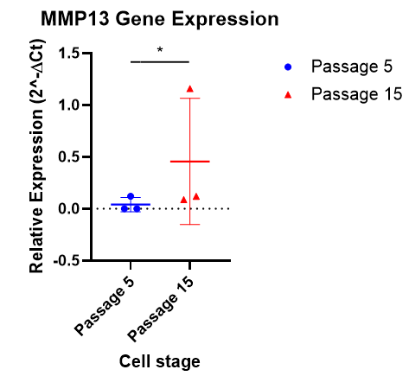
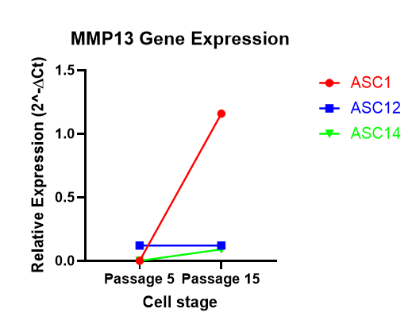
Results
Gene expression of MMP13
Figure 17: Gene expression of MMP13 according to passage using qPCR. T-test performed
Significance is denoted by *(p<0.05), ** (p<0.01), *** (p< 0.001), **** (p<0.0001).
Notes:
Donor specific response re MMP13

Slide 16
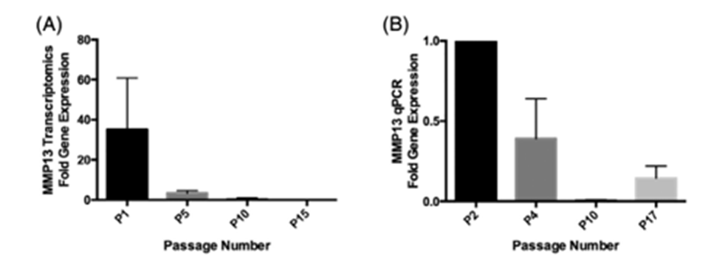
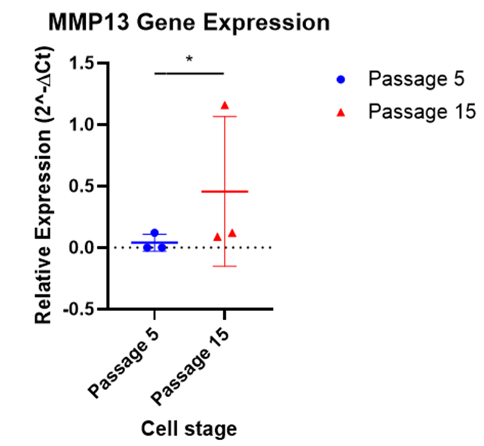
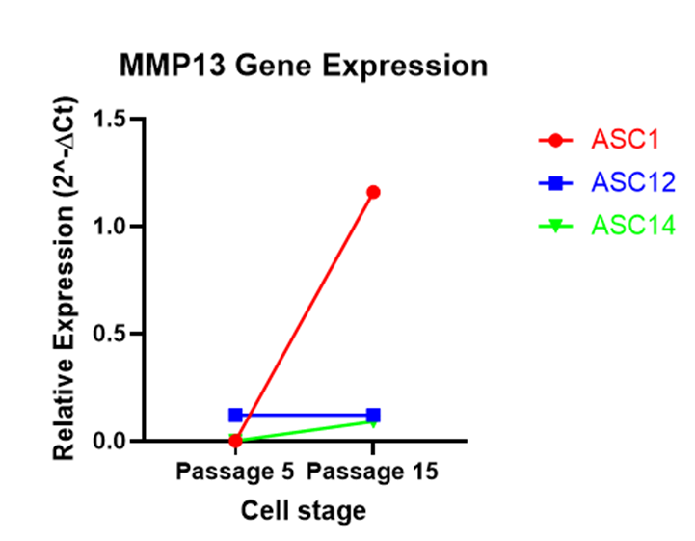
Results
Gene expression MMP13 comparison to Human Study
Figure 18: Gene expression of MMP13 according to passage using transcriptomics. Figure adapted from Salerno et al., 2020
Figure 19: Gene expression of MMP13 according to passage using qPCR. Figure adapted from Salerno et al., 2020
Figure 20: Gene expression of MMP13 according to passage using qPCR. T-test performed
In humans, MMP13 levels were high at the beginning then decreased with passage
Whereas in horses MMP13 levels were low at the beginning and then stayed the same/increased. Variance in donors.
Notes:
Human study low passage- MMP13 expression high and TIMP 1 -> See that possible trend in later passage in horse/ specific donors-> engraftment and chondrogenesis
However, need to look into this more to be certain of a trend

Slide 17
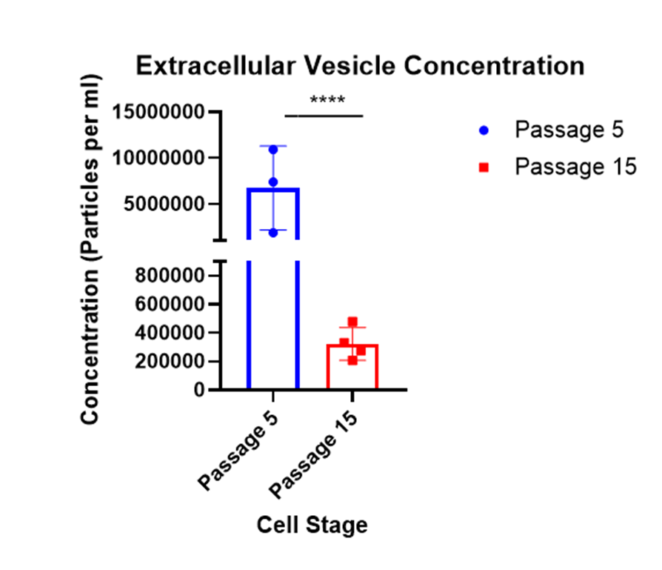
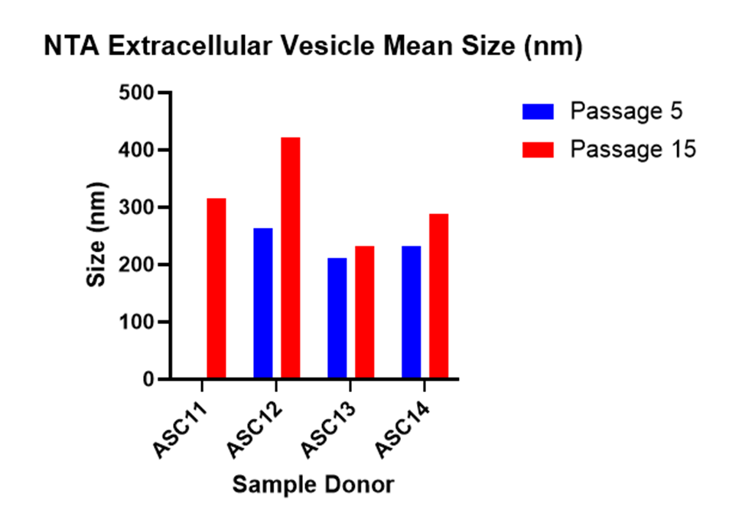
Results
Nanoparticle Tracking Analysis of extracellular vesicles
Figure 21: Concentration of EVs according to passage. Nanoparticle tracking analysis was undertaken using a Nanosight NS3000. T- test performed.
Figure 22: EVs mean size. Nanoparticle tracking analysis was undertaken using a Nanosight NS3000.
Significance is denoted by *(p<0.05), ** (p<0.01), *** (p< 0.001), **** (p<0.0001).
Notes:
We largely think that stem cells act by what they secrete (trophic repair). If the number of vesicles they secrete decreases over time that is something we have to face as it could create issues with creating immortalized cells for treatment etc. as that means they lose their stemness with passage
Other literature says
Lower passage and collecting from low densities = more evs,
(would need to ensure confluence was the same)

Slide 18
Conclusion
Summary
  TIMP1 gene expression increased across donors' passage
    Similar to human study, where protein expression remained high
  MMP13 expression appeared to have more donor specific variance: staying the same/increasing
    Contrasting the human study where gene expression decreased with passage
Conclusion
  Sustained TIMP1 gene expression in equine MSCs supports the hypothesis of potentially being a good treatment option via trophic repair. TIMP1 could be explored as a therapeutic target in treatment of osteoarthritis in horses
  However, the effects of MMP13 in horses may be more donor specific, requiring further investigation.
  MSCs appeared to sustain some of their stemness across passage
Limitations
  Limited sample size
  Gene expression not yet correlated to protein expression
Next Steps
  Do an ELISA, Western Blot then Proteomics
  Explore the effect of TIMP1 and MMP13 on the proteome of stimulated cells
Notes:
next step is does timp1 and MMP13 protein expression show some trend as gene expression….

Slide 19


Acknowledgements
University of Liverpool
Dr Emily-Jayne Clarke (Department of Musculoskeletal Biology and Ageing Science, Institute of Life Course and Medical Sciences, University of Liverpool)
Prof Mandy J Peffers (Department of Musculoskeletal Biology and Ageing Science, Institute of Life Course and Medical Sciences, University of Liverpool)
Beaufort Cottage Educational Trust/ Gerald Leigh Charitable Trust Veterinary Summer Scholarships
- Provided funding

Slide 20
References
(1) Wang, M., Sampson, E.R., Jin, H., Li, J., Ke, Q.H., Im, H.J., & Di, C. (2013). MMP13 is a critical target gene during the progression of osteoarthritis. Arthritis Res Ther 15, R5 https://doi.org/10.1186/ar4133
(2) Ries C. (2014). Cytokine functions of TIMP-1. Cellular and molecular life sciences : CMLS, 71(4), 659–672. https://doi.org/10.1007/s00018-013-1457-3
(3) Thorpe, C. T., Clegg, P. D., & Birch, H. L. (2010). A review of tendon injury: why is the equine superficial digital flexor tendon most at risk?. Equine veterinary journal, 42(2), 174–180. https://doi.org/10.2746/042516409X480395
(4) McIlwraith, C.W., Frisbie, D.D. and Kawcak, C.E. (2012) ‘The horse as a model of naturally occurring osteoarthritis’, Bone Joint Res, 1(11), pp. 297–309. doi:10.1302/2046-3758.111.2000132.
(5) Murray, R. C., Birch, H. L., Lakhani, K., & Goodship, A. E. (2001). Biochemical composition of equine carpal articular cartilage is influenced by short-term exercise in a site-specific manner. Osteoarthritis and cartilage, 9(7), 625–632. https://doi.org/10.1053/joca.2001.0462
(6) De Sousa, N.R., Luna, S.P., Pizzigatti, D., Martins, M.T., Possebon, F.S., Aguiar, A.C.( 2017) 'Relation between type and local of orthopedic injuries with physical activity in horses', Ciencia Rural, 47:1–7. doi: 10.1590/0103-8478cr20151218
(7) Jammes M, Contentin R, Cassé F and Galéra P (2023) Equine osteoarthritis: Strategies to enhance mesenchymal stromal cell-based acellular therapies. Front. Vet. Sci. 10:1115774. doi: 10.3389/fvets.2023.1115774
(8) Ferris, D.J., Frisbie, D.D., Kisiday, J.D., McIlwraith, C.W., Hague, B.A., Major, M.D., Schneider, R.K., Zubrod, C.J., Kawcak, C.E. and Goodrich, L.R. (2014), Clinical Outcome After Intra-Articular Administration of Bone Marrow Derived Mesenchymal Stem Cells in 33 Horses With Stifle Injury. Veterinary Surgery, 43: 255-265. https://doi.org/10.1111/j.1532-950X.2014.12100.x
(9) Salerno, A., Brady, K., Rikkers, M., Li, C., Caamaño-Gutierrez, E., Falciani, F., Blom, A. W., Whitehouse, M. R., & Hollander, A. P. (2020). MMP13 and TIMP1 are functional markers for two different potential modes of action by mesenchymal stem/stromal cells when treating osteoarthritis. Stem cells (Dayton, Ohio), 38(11), 1438–1453. https://doi.org/10.1002/stem.3255
(10) Lin, C. S., Ning, H., Lin, G., & Lue, T. F. (2012). Is CD34 truly a negative marker for mesenchymal stromal cells?. Cytotherapy, 14(10), 1159–1163. https://doi.org/10.3109/14653249.2012.729817

