Slide 1
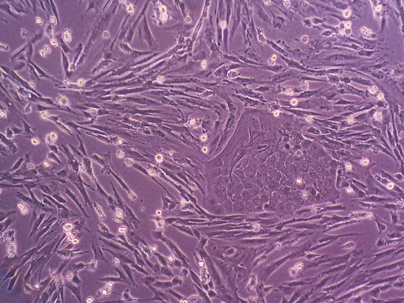


Cell Morphologies and Protein Changes in the Periodontal Ligament of EOTRH Affected Teeth
Alex Monks – 3rd Year Vet Student
Supervisors: Prof. Mandy Peffers & Anders Jensen
Institute of Life Course and Medical Sciences, Faculty of Health and Life Sciences
Notes:
Introduce myself
-Alex Monks
3rd year vet student at university of Liverpool

Slide 2
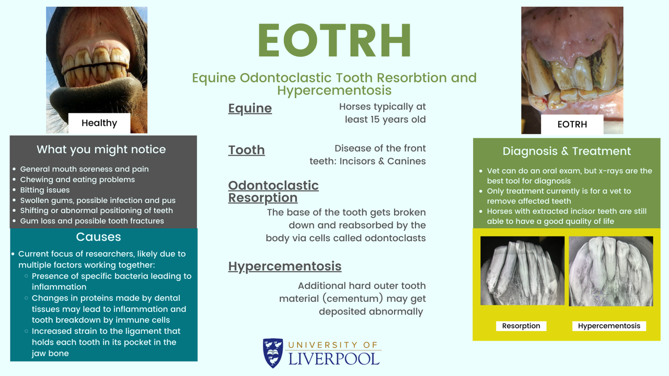
Notes:
Some background:
infographic - disseminate on social media to horse owners and lay people to educate them about this disease
EOTRH = equine odontoclastic tooth resorption and hypercementosis
progressive dental disease of the incisors of predominantly older horses
Recently recognized and named disease (2007)
Welfare issue – pain, inflammation, shifting and degradation of teeth – interferes with ability to eat, riding/bit problems
Aetiology unknown – several prevailing theories – immune response possibly with bacterial involvement and mechanical forces
Diagnosis – best done via x-rays
Treatment – remove teeth
The disease slowly becoming more widely recognized and diagnosed, but still remains relatively unknown in the equine industry

Slide 3
Background
First defined and named in 2008
Periodontal ligament (PDL)
Between cementum and alveolar bone
Aetiological theories
Periodontal inflammation
Gram-negative bacteria (Treponema, Tannerella)
Mechanical forces
Recent research – EOTRH cementum proteomics
Increase in inflammatory proteins
Neutrophil degranulation pathway
Notes:
Relatively newly defined disease – overall pool of research in EOTRH is limited – many are small case studies, or looking to generate better diagnostic criteria or methods, some epidemiological studies. Very few studies looking into changes in the periodontal ligament
Really big research question – what causes the EOTRH changes to occur?
One main theory is that inflammation of the periodontium triggers resorption and hypercementosis, additional research has looked at the role of gingival bacteria – they found that gram-negative bacteria were more commonly identified in the gingival crevicular fluid of diseased horses – possibly a trigger of inflammation
Another prominent theory hypothesizes that mechanical forces cause damage and degeneration of the PDL, causing resorption and leading to hypercementosis as a means of stabilizing the teeth. Believed to be due to changing angles of teeth, and reduction in overall tooth length/mass as a horse ages
Recent research has looked at cementum proteomics in EOTRH affected teeth – found increased proteins related to inflammations, and pathway analysis shows up-regulation of neutrophil degranulation pathways
-other canonical pathways activated/increased included unfolded protein response, and degredation of ECM
-in order to figure out what triggers the changes, we need to better understand what exactly is happening in these changes – pathway of resorption/hypercementosis

Slide 4
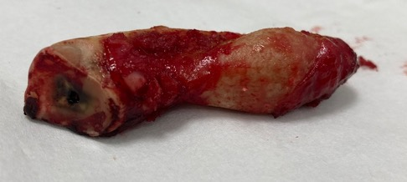
Research Aims
To explore the protein changes that occur within the periodontal ligament (PDL) of EOTRH affected teeth
Periodontal ligament cell culturing and staining from diseased teeth
Proteomic analysis of PDL tissue from diseased
and healthy teeth
Proteomic analysis of PDL cells from culture
Notes:
PDL cell culturing
-What cell populations are we able to isolate and culture from the periodontal ligament (PDL)
PDL tissue proteomics
-What are the differentially abundant proteins between the two populations
PDL cell proteomics
-What differences in proteins are there between cell morphologies

Slide 5
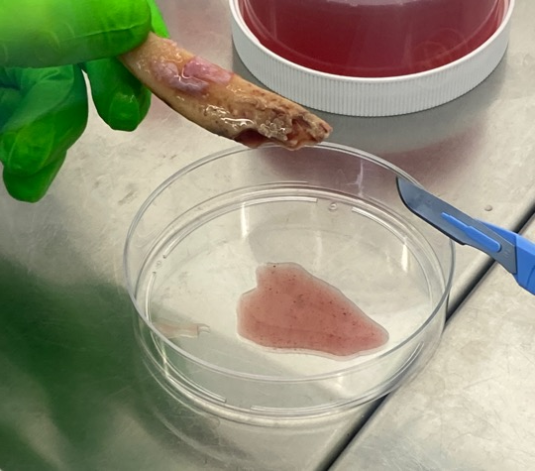
Teeth and Cells
Ethics obtained from UoL
Diseased teeth: North Wales Equine Dental Practice
Healthy teeth: Abattoir heads
PDL tissue scraped from teeth
Digested in collagenase type I for 1 hour
Strained and seeded in culture flasks
Flasks cultured at 37°C and 5%CO₂
Notes:
Diseased teeth were obtained from Dr. Andy Peffers at North Wales Equine Dental Practice
-teeth were extracted as part of planned dental procedures for horses affected by EOTRH
Healthy teeth were obtained from abattoir heads
Teeth were placed in cultivation media as soon as they were removed from the horse, and cells were isolated the following day
-PDL tissue was scraped off of the mid 1/3 of the tooth – avoiding gingiva and dental pulp
-Collected tissue was digested in collagenase type 1 for 1 hour at 37*C, centrifuged, supernatant removed, resuspended in cultivation media (to wash collagenase).
Filtered through 70um cell strainer, centrifuged again, supernatant removed, and resuspended in minimal cultivation media before seeding onto T25 cell culture flasks
Flasks were cultured at 37*C, 5% CO2 95% air
Media changed every Monday and Friday, flasks were passaged as necessary when confluence was greater than 80%
We attempted 2 times in this project, and at least 2 times prior to this project to culture cells from healthy teeth obtained from abattoir heads, but in all cases, cell cultures became rapidly infected. As such, no healthy cells were able to be cultured in this project
Cultivation media (if anyone asks)
DMEM-high glucose
1% pen/step
Fungizone
10% FBS

Slide 6
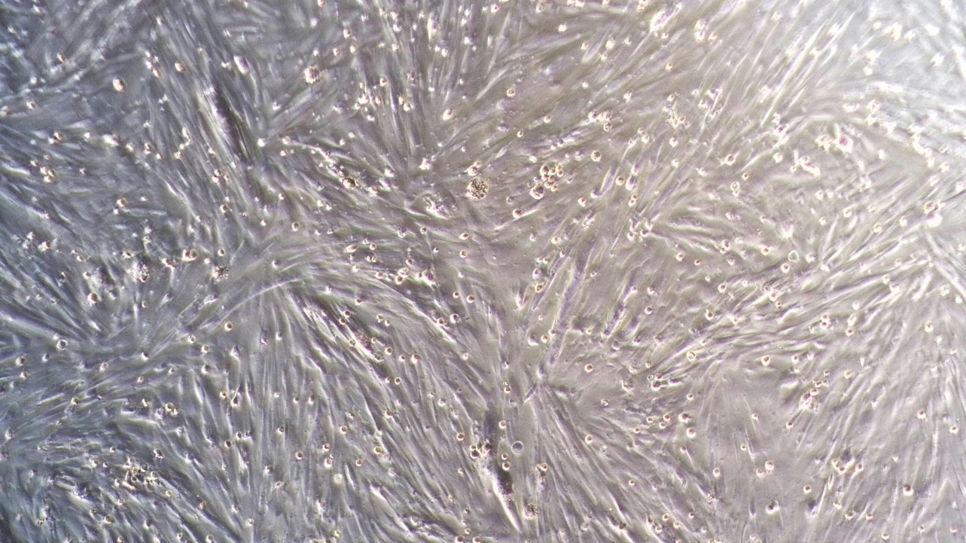
Low Power
Spindeloid Cells - Fibroblasts
Notes:
Low power
As expected, the most prominent cell type cultured were spindeloid fibroblast cells
-They were consistently grown from every donor, and their morphology and behaviour matched description in relevant literature
-Fibroblasts make up the majority of the cell population of the PDL, they provide the structure and organization of the ligament to hold cementum to bone

Slide 7
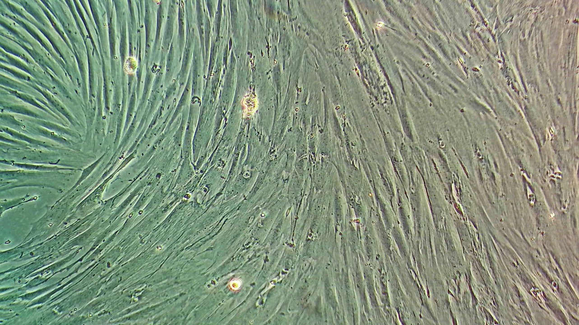
Medium Power
Spindeloid Cells - Fibroblasts
Notes:
Medium power
These formed a monolayer of waves and whorls, once established, reached confluence at a moderate pace, and were easy to detach with Trypsin/EDTA to passage

Slide 8
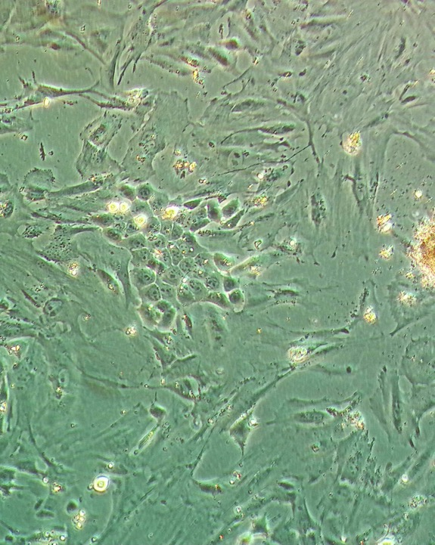
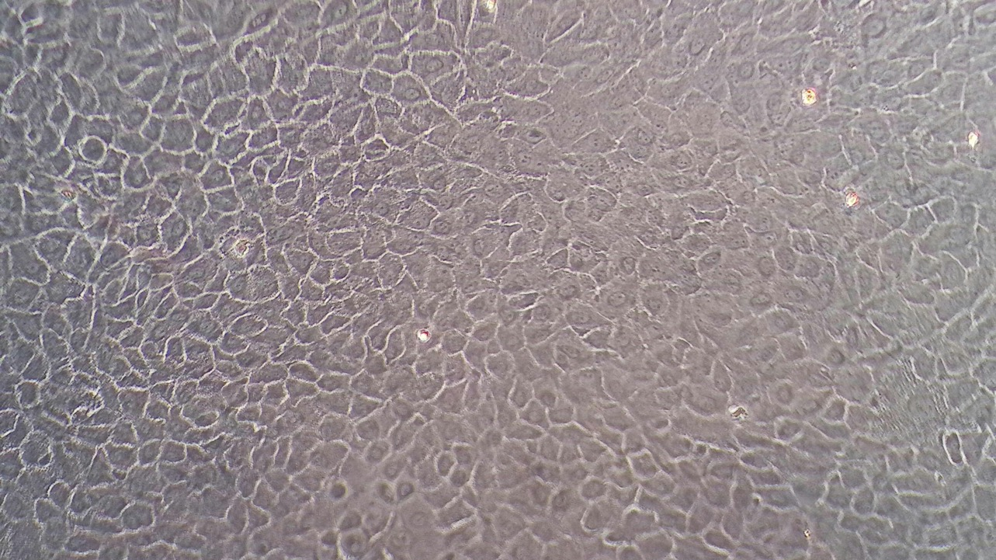
Medium Power
Cobblestone Cells - Cementoblasts
Notes:
Medium power
Second morphology – distinct from first fibroblast morphology
Not a lot of literature looking at/describing cell morphology of cementoblasts (or really any other cell types of the periodontium)– especially in hypsodont species – what does exist is looking at inducing changes in an immortalized cell line from mice, and often imaged using an electron microscope, or histological section of tooth, PDL, and alveolar bone
Would start out like on the right, a small colony of rounder, plumper cells compared to the fibroblast like cells and then develop into entire colonies like on the left
Stazyck and Gasse 2007 – sample pair who named EOTRH, released a paper the year before, looking at primary cultures of fibroblasts and cementoblasts in equine periodontium
Cells obtained and cultured in very similar ways to the protocol I used
Identified two cell types, which they labelled as equine periodontal fibroblasts (EPF) and equine dental cementoblasts (EDC)
The described morphology was comparable to what I found in my cells

Slide 9
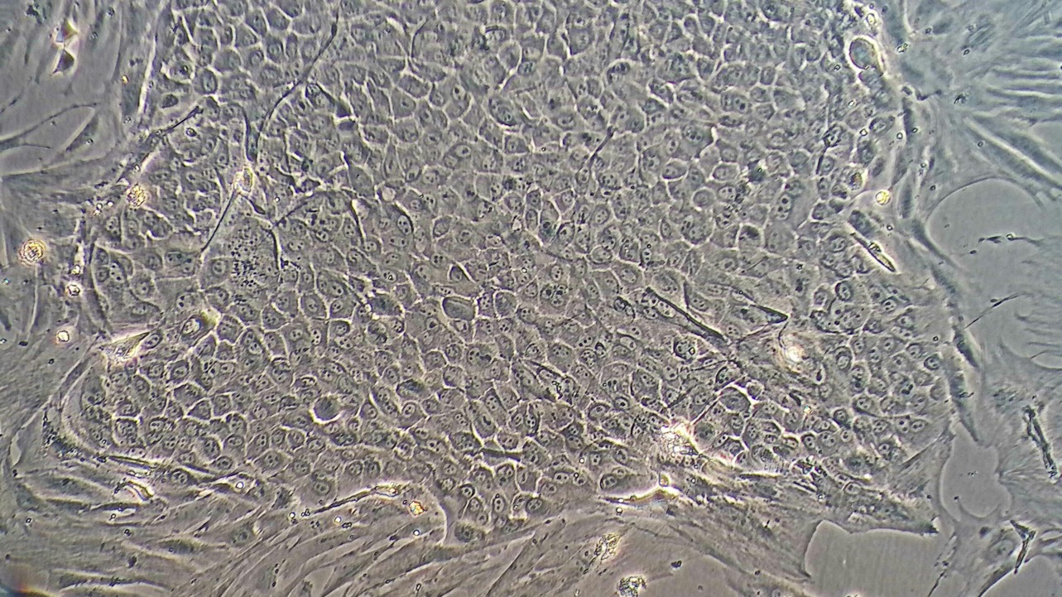
Medium Power
Cobblestone Cells – Distinct Colonies
Notes:
Medium power
Behavior – different from fibroblasts – which grew and divided happily in waves and whorls, just filling in whatever space was available
Cobblestone cells – formed distinct colonies, and took over any fibroblasts they came across
-each colony has a thick border – best seen in low power

Slide 10
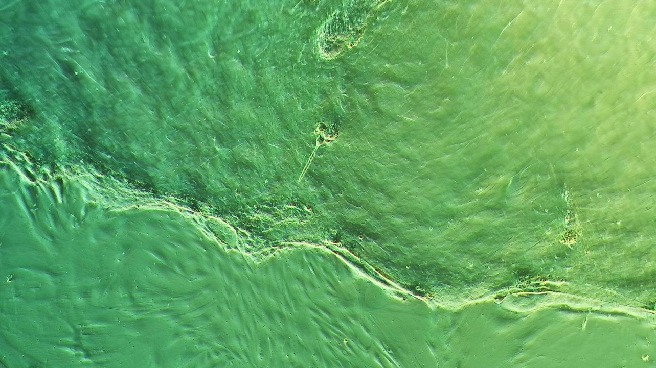
Cobblestone Cells – Colony Borders
Low Power
Notes:
Cobblestone cells – formed distinct colonies, and took over any fibroblasts they came across
-each colony has a thick border – best seen in low power – appreciation for thickness of border
-colonies would expand as a unit – would never see a single cobblestone cell reaching out of colony to expand. If colonies came in contact with each other – they would merge
Fibroblasts never took over space already inhabited by cobblestone cells – but it would happen the other way around

Slide 11
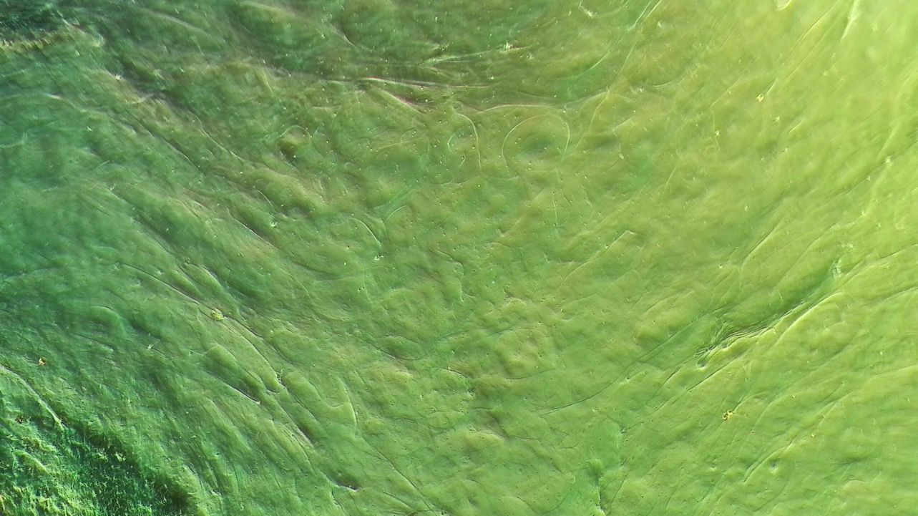
Low Power
Cobblestone Cells – Colony Matrix
Notes:
Medium power
Cobblestone colonies seemed to produce an extracellular matrix that covers the whole colony – something that was not found with the fibroblasts
-notice on previous slide, you can identify individual fibroblast cells outside of the cementoblast colony, but on both the previous slide and this slide, you cannot distinguish individual cementoblast cells
We hypothesized that this was related to cementum – would be a type of calcium deposition or secretion of extracellular matrix
To check for calcium deposition, we then used a protocol for alizarin red staining

Slide 12
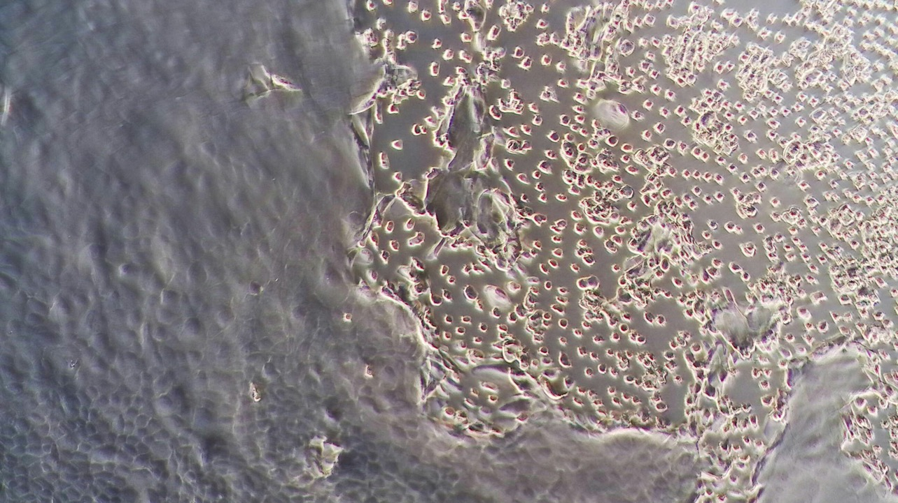
Low Power
Cobblestone Cells – Colony Adhesion
Notes:
Medium power
Cobblestone colonies once established, adhered to the cell culture flasks very strongly
The fibroblast cells could be detached easily with trypsin/EDTA solution to be moved or passaged
-solution would work within 3-5 minutes for fibroblasts
The cobblestone cells were much harder to remove from the flasks – suspected to be in part because of the extracellular matrix/secretion the colonies produced.
This image here shows the eventual break down of the extracellular matrix to expose the cobblestone cells, and only once exposed would the trypsin/EDTA solution be able to detach the cells
-also noted, the disruption of the ECM seemed to happen first at the edges of the colony, and then slowly work inward
-as such, detachment of cobblestone cells took much longer – at least 10 minutes for significant numbers of cells to become detached
-this presented challenges in that cells left in trypsin/EDTA solution can become damaged – especially extracellular or membrane proteins

Slide 13
Alizarin Red Staining
Stain that binds to calcium depositions
Not definitive for cementoblasts, but does help to rule out other cell types such as gingival epithelial cells
Moved selection of cells to 6 well plate, let them grow for 5 days, fixed and stained, then quantified staining
3 cell populations
Fibroblast cells
Cementoblast cells
Mixed population
Notes:
To confirm the matrix formation involved calcium deposition, we stained the cells with Alizarin red which binds to calcium deposits - the more calcium, the more stain binds, the more red the cells will become
-Not just cementoblasts - other cells do this too, but considering where we isolated the cells from,

Slide 14
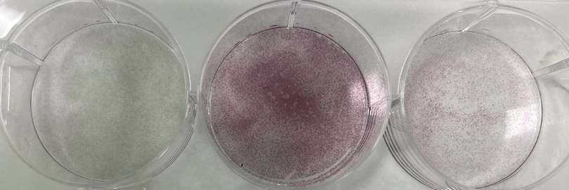
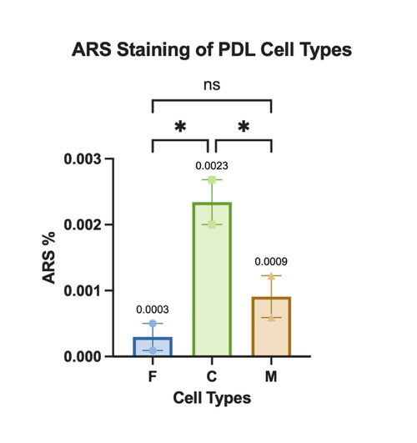
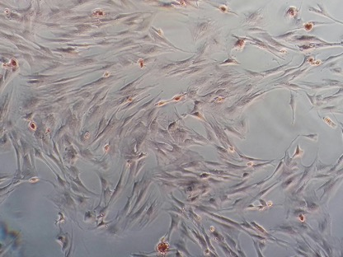
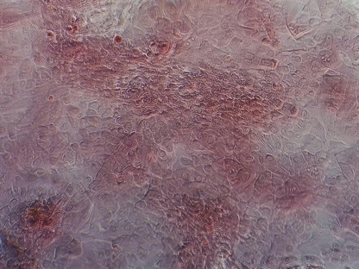
Results - Alizarin Red Staining
F
C
M
F
C
Notes:
Compared stain uptake of 3 different cell populations
F - fibroblast only cells
C - cementoblast-like only cells
M - mixed fibroblast/cementoblast cell population
-Top left shows the plates of cells after staining
-to naked eye, cementoblast like cells seem to have taken up significantly more dye - also supported microscopically (bottom left)
Mashed up cells in liquid solution, measured light absorbance, compared to standard set up known dilutions of stain to caculate how much stain was taken up by cells
-Quantitatively analyzed the stain uptake of the three different cell populations - the cementoblast-like cells took up significantly more stain than either of the other two cell populations.
Of note, the cells only had 5 days to attach, proliferate, and in the case of the cementoblasts, produce calcium deposits – would be very interesting to grow both types of cells for longer and see if amount of stain taken up increases in the cementoblast population

Slide 15
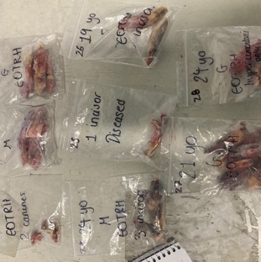
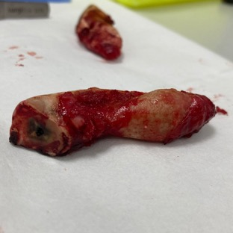

Methods – PDL Tissue Proteomics
Biobank Teeth
Harvest PDL Tissue
Digest & Proteomics
Notes:
While my cells were initially growing, we proceeded to investigate the global protein changes in the periodontal ligament as a whole in diseased and healthy samples
As with the teeth we harvested cells from, the teeth for this protocol were obtained in the same manner, just over a longer period of time and stored as part of the Peffers lab biobank at -80*C
-Healthy teeth came from abattoir horses – were not euthanized for dental reasons, and had no gross signs of EOTRH
Started with teeth from 5 diseased horses, and 5 healthy horses
-Selection criteria:
-had to have at least 4 incisors from a horse – to pool the collective PDL to ensure enough protein for digestion and proteomics
-good visible PDL to harvest – sometimes PDL is lost in extraction process
-no obvious signs of infection (necrosis, smell, etc.)
-all samples were from horses between the ages of 19 and 27
-Attempted to age match – initial selection had 4 age matched sets, and 1 set age matched within 3 years
-Tissue digestion and protein extraction preparation for Liquid Chromatography-Tandem Mass Spectrometry
Tissue samples were mechanically digested using ultrasonication, before being protein was chemically isolated
6 samples ran cleanly – 3 healthy, 3 diseased, 4 samples did not run cleanly enough to produce useable data
Analysis of chromatographs using maxquant, MASCOT, and UniProt, data analysed using R – differential abundance

Slide 16
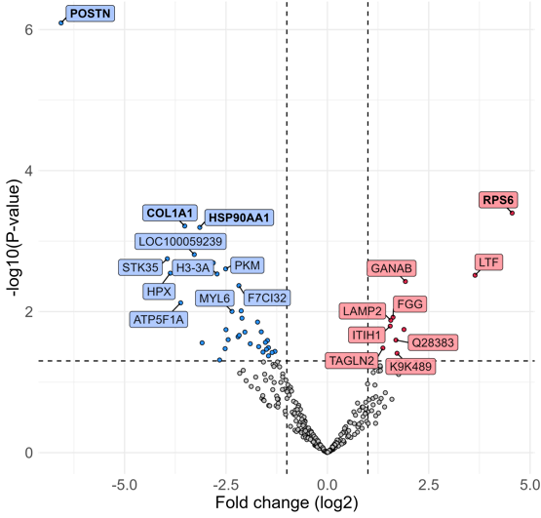
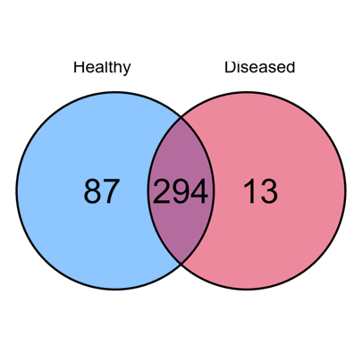
Results – Tissue Proteomics
Diseased vs Healthy PDL Tissue (n=3)
394 unique proteins identified
Calculated differential abundance with fold change and statistical significance
Notes:
After running samples through the mass spectrometer, and analyzing chromatographs, we had useable data for 3 healthy samples and 3 diseased samples.
Overall we found 394 unique proteins, 87 found only in healthy samples, 13 found only in diseased samples, and 294 found in both – Venn diagram
Chromatographs analyzed with maxquant, stats done with R
R was used to calculate statistically significant proteins of the 294 proteins found in both diseased and healthy samples
- those with a fold change ≥1.30 and a p value ≤0.5
Volcano plot - statistically significant difference in protein content in healthy vs diseased.
*differential abundance and fold change (p≤0.5, and FC≥2.0)
-blue - decreased in diseased vs healthy
-red - increased in diseased vs healthy
Intensity of each variable in a given sample is divided by the median of intensities of all variables in the sample and then multiplied by the mean of median of sum of intensities of all variables in all samples. The normalized data is then log2-transformed. (median normalisation)
Limma for differential expression
BH benjamini Hochberg p value adjustment

Slide 17
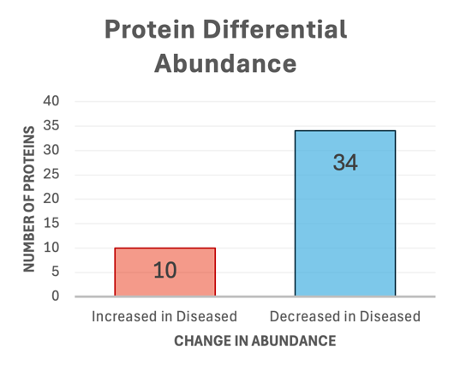
Extracellular Matrix Proteins
Proteins with decreased differential abundance in diseased samples include:
Extracellular matrix (ECM) organisation and cell adhesion proteins
POSTN, COL1A1, COL6A1, COL6A3, LUM, OGN, DCN, ASPN, VCN, FN1
Poor ECM organisation
Notes:
Overall, 10 proteins statistically increased abundance in diseased samples, and 34 proteins statistically decreased in abundance
Decrease in structural and remodelling proteins
Type 1 collagen – main type of collagen in PDL
Type 6 collagen – microfibrils that link main collagen fibres to basal lamina
POSTN – periostin – tissue remodelling, fibrosis
LUM – lumican – regulates collagen fibril assembly & spacing – organisation
OGN – Osteoglycin – regulating collagen fibrillogenisis
DCN – decorin – collagen fibril diameter, inhibits TGF-beta
ASPN – asporin – negatively regulates mineralisation -> so decrease ASPN = more mineralisation
VCN – versican – cell adhesion
FN1 – fibronectin 1 – cell-cell and cell-substrate adhesion, wound healing, tissue repair

Slide 18
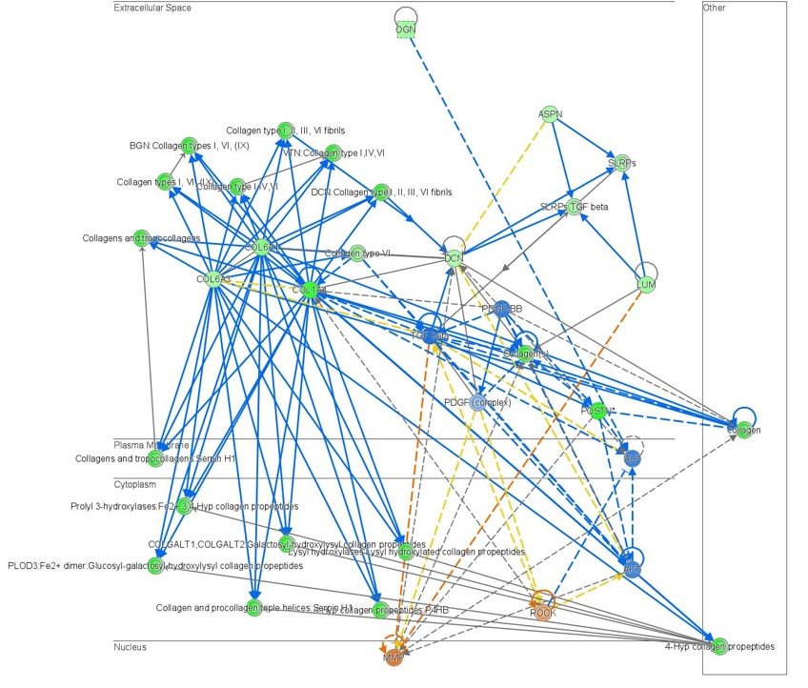
Extracellular Space
Plasma Membrane
Cytoplasm
Nucleus
Notes:
Used ingenuity pathway analysis to understand the role of increased or decreased proteins on pathways, as well as possible upstream regulators and down stream effects
A large number of the proteins that were significantly decreased in the diseased samples were involved in extracellular matrix organisation
- collectively resulting in -impaired capacity for structural repair, less robust ECM, less control over collagen organisation, reduced adhesion and scaffolding
This diagram shows a large variety of ECM related proteins, where each protein would be found, as well as its relation and effect on other proteins.
Green circles – canonically decreased in diseased samples
Blue lines – inhibitory/negative effect on a subsequent protein

Slide 19
Immune Related Proteins
Several proteins related to immune function only found in diseased samples
Azurocidin, lymphocyte cytosolic protein 1, lysozyme, proteinase 3, calgranulin,
Involved in: neutrophil granules, antimicrobial activity, activation of T-cells or other inflammatory processes, neutrophil migration
Increased in diseased samples:
Lactotransferrin, fibrinogen gamma chain, lysosome-associated membrane protein 2
Neutrophil granules, antimicrobial activity, bone remodelling
Acute phase inflammatory response
Lysosomal activity, autophagy/phagocytosis
Notes:
AZU1 – azurocidin – neutrophil granules, antimicrobial activity
found in all 3 diseased samples
LCP1 – lymphocyte cytosolic protein 1 – activation of T-cells
found in all 3 diseased samples
LYZ – lysozyme – neutrophil granules – antimicrobial activity (Gram +)
PRTN3 – proteinase 3 – neutrophil granules –, triggers inflammatory processes, neutrophil migration
S100A8/S100A9 – Calgranulin-A & B – inflammatory/immune responses, neutrophil migration
LTF – lacotransferrin – iron sequestration – bacteriostatic – starves bacteria of necessary iron
-bactericidal – penetrates and disrupts microbial membrane
-released by neutrophils at sites of infection – sign of neutrophil infiltration and active immune response
FGG – fibrinogen gamma chain – acute phase protein – sign of inflammation
LAMP2 - lysosomal membrane protein – lysosomal activity, autophagy/phagycytosis involved in clearing bacteria and damaged cellular debris related to infection and inflammation
Note that due to lack of these protein in the healthy samples, we are unable to statistically evaluate their amount – challenge of proteomics – possible to ‘miss’ proteins – would need to test more samples – but interesting never the less

Slide 20
Oxidative Stress & UPR
Increase in proteins related to cellular stress and quality control – unfolding protein response (UPR)
HSPA5, GANAB, SSR1
Decrease in proteins related to anti-oxidant proteins
SELENBP1
Unfolding protein response – endoplasmic reticulum (ER) quality control system, can be triggered by oxidative stress
Chronic inflammation leads to constant reactive oxygen species (ROS), which causes protein damage and drives UPR
Possible interaction with HIF1a Warburg effect
Notes:
Chronic inflammation leads to the production of reactive oxygen speceis, as does high mitochondrial activity
ROS cause damage to proteins, including those in ER – leading to accumulation of misfolded proteins, which activates the UPR
-but what happens in a disease state, if this cycle is dysregulated for example, or overwhelmed? – something to look into
Several proteins increased in diseased samples are associated with endoplasmic reticulum (ER) stress
-HSPA5 – master regulator of unfolding protein response – UPR
-shown in humans to be increased in PDL cells associated with periodontitis
GANAB – glucosidase II alpha subunit
-potential ER-autophagy related biomarker
-suggests activation and/or dysregulation of pathways for controlling the volume in the ER and degrading excess/misfolded proteins
SSR1 – signal sequence receptor subunit 1
-component of protein moving machinery on ER – tied to overall protein folding and quality control system
-likely increased due to cells effort to cope with increased demand for protein transport – caused by chronic inflammation or excess misfolded proteins
SELENBP1 – selenium binding protein
-tumour suppressor and part of cellular anti-oxidant system
-reduction makes cells more susceptible to oxidative stress (hallmark of periodontitis)
-supposed to protect tissues from enzymes released during inflammatory response
-activated neutrophils generate large amounts of reactive oxygen species (oxidativec stress)
HIF1a pathway controls the Warnburg effect-
-HIF1a upregulates glycolysis and downregulates oxidative phosphorylation
-

Slide 21
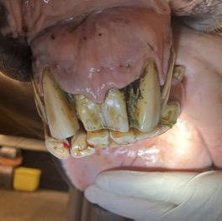
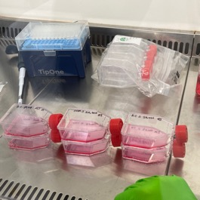
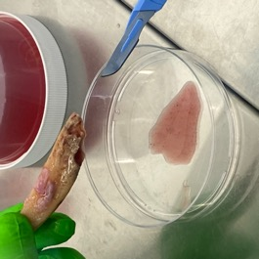

Methods – PDL Cell Proteomics
Extract Teeth
Harvest PDL Cells
Culture Cells
Harvest & Proteomics
**Staining**
Notes:
Once the cells had been cultured, and sufficiently grown and passaged – used similar protocol as previously to do proteomic analysis on 3 different cell lines
As explained in the morphology section, some of those same cells were digested for proteomics
-3 cell lines – fibroblast only – P0 fibroblast only – P2, cementoblast only – P2
Only had 1 sample for each of the three cell lines – limited the types of analysis we were able to do

Slide 22
PDL Cell Proteomics: Cementoblast Cells
Cementoblast cells showed higher concentrations of proteins invovled with aerobic respiration, mitochondrial function, and glycolysis
Also increases in proteins related to antioxidant defense, misfolded protein management
Some increases in proteins related to cytoskeletal structure and cell adhesion
Decreased vimentin
Possible mesenchymal to epithelial transition
Reduced migration, change in cell shape
Notes:
Lots of proteins increased in relation to glycolysis, mitochondrial function – oxidative phosporylation
-suggests high metabolic activity – in line with rapid proliferation seen in culture
-proteins related to management of hydrogen sulfide – toxic byproduct of electron transport chain
Misfolded protein management – HSPB1, PDIA3
-bind to misfolded proteins to stop them aggregating and flag for refolding/destruction
Cytoskeletal structure and cell adhesion – again in line with adhesion and strucutre seen in culture

Slide 23
PDL Cell Proteomics
Only one sample of each cell type – unable to do differential abundance
Use emPAI score
Lots of missing values – hard to compare if a given value is raised or lowered
Is protein actually not present, or was it just not identified
Lots of uncertainty in proteomics, confounded by small sample size
Notes:
emPAI score – exponentially modified protein abundnace index
-label free, semi-quantitative method
-estimates relative abundance of protein
-allows for relative comparison of estimated abundance

Slide 24
Summary
Successfully cultured PDL cells from EOTRH affected teeth
Two cell morphologies
Alizarin red staining
Successfully obtained proteomics data from PDL tissue – healthy and diseased
ECM dysfunction, immune function, ER UPR and oxidative stress response
Proteomic analysis of PDL cells
Mixed results
Notes:
Successfulyy cultured PDL cells from EOTRH affected teeth
-two morphologies – expected firboblast cells, and second rarely described cobblestone morphology, hypothesised to be cementoblasts
-successfully stained cultured cells with alizarin red to look for calcium deposits – much more calcium deposition in hypothesised cementoblast cells
PDL tissue proteomics
-decrease in large number of ECM proteins in diseased tissue
-presence of immune related proteins not foundin healthy tissue
-inflammation, possible bacterial origin or involvement
-UPR and oxidative stress
-changes to ER related proteins, centering around oxidative stress and protein misfolding – needs more investigation
PDL cell proteomics
-mixed results, some differences observed in hypothesised cementoblast cells I line with what was seen in culture – cuboidal cells, matrix production, high proliferation rate – high mitochondrial activity

Slide 25
Limitations
Culturing healthy PDL cells
Lack of cementum marker proteins mapped in horses
CAP and CEMP1 in humans, mice, rats, bovines
Resorption and hypercementosis timeline differences – why?
Small sample size
Differential abundance, missing values
Age matching and ability to identify early EOTRH in healthy teeth
Notes:
Consistent issues being able to culture healthy PDL cells – suspected due to extraction from abattoir heads – thoughts for future include using wolf teeth
2. Would like to have more definitive ways of determining if cells are cementoblasts – in humans and mice, two cementoblast marker proteins have been found and mapped – CAP – cementum attachment protein and CEMP1 – cementum protein 1
-but neither of these proteins has been looked for/found/mapped in horses
3. Not all horses with EOTRH follow the same progression order
-some only get resorption, some only get hypercementosis, some get one before the other and others vice versa – this makes it harder to understand and draw a definitive pathway of disease – why do changes happen in different orders in different horses?
4. Despite trying for n=5 each in the tissue proteomics, only 3 of each ran cleanly – look into whether that was due to preparation/protocol issues, or machine issues
-we’ve shown differences between the two, would be relatively easy to expand to more samples
5. Small sample size
-in the cell proteomics, this inhibited our ability to compare protein concentrations, unable to do differential abundance,
-with more samples, each missing value becomes less impactful/important – get a much better idea of the whole picture
-while better with tissue proteomics – same holds true – esp. with 4 out of our 10 original samples not producing useable data
5. Our healthy teeth are chosen due to lack of observable signs of EOTHR, but no x-rays are taken – so very possible to choose horses that may in fact have early EOTRH that is not noticed.
one way to reduce the chance of this is to use younger healthy donors, but then you loose the ability to discount normal age related changes

Slide 26
Future Directions
Larger sample size
Confirmation of cementoblast-type cells
CAP, CEMP1
Define PDL stem cells to then isolate
How does differentiation change in disease state
Cementoblast origins
Testing protein differences in resorptive vs hypercementosis vs mixed presentation
Better records of demographics from extracted donors
Notes:
1. larger sample size for proteomics analysis – for reasons described in previous slide
Would like to be able to more definitively confirm cementoblast-like cells
-mapping CAP and CEMP1 in horses
2. PDL stem cells not well defined – under broad category of mesenchymal stem/stromal cells – but many if not all of the markers and behaviors of MSCs can be found in or done by fibroblasts – which are the major cell population of the PDL
-would want to look at their ability to differentiate into cementoblasts or osteoclasts and does this change in disease states
-current literature is mixed a to what the progenitor/precursors of cementoblast cells is – PDL SCs, dental pulp SCs, or from epithelial rests of malassez
-hypsodont vs brachydont teeth, elodont – most studies are done with either human or mice teeth – neither of which have hypsodont, anelodont teeth – how much is the same/applicable
3. We don’t know why some horses only get resorptive lesions, others only hypercementosis, and others mixed presentation
could look at PDL or cementum protein differences between the different categories
to properly separate the three categories, good demographic records of donated/extracted sample teeth would be needed – most of the time, x-rays are taken before teeth are extracted – best way to categories presentation. Would also be good to track age, and how long has EOTRH or signs been observed in the horse

Slide 27




Acknowledgements
University of Liverpool
Prof. Mandy Peffers, Anders Jensen, and the rest of the Peffers lab
Guidance, knowledge, support, and help throughout the project
Gerald Leigh Charitable Trust & Beaufort Cottage Educational Trust
For funding and organising the summer studentship and presentation day
North Wales Equine Dental Practice
Dr. Andy Peffers – Extracting and providing diseased incisor samples

