Slide 1
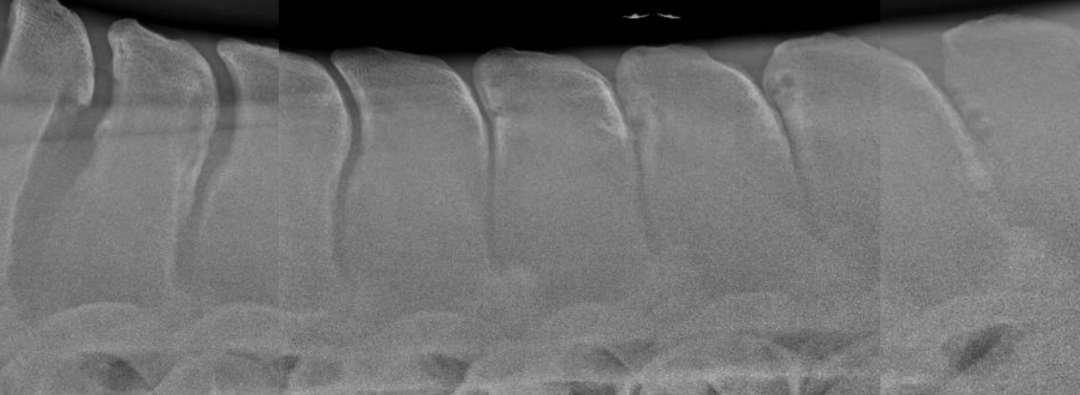
Investigation of a novel surgical approach for the treatment of kissing spines in horses
Eilidh MacDonald
Under the supervision of David Stack and Maurice Connaughton
University of Liverpool
UK Veterinary Summer Studentship
Kindly sponsored by the Beaufort Cottage Educational Trust
Notes:
Hello, I am veterinary student from the University of Liverpool.
It is a privilege to present here today. I am grateful to Beaufort Cottage Educational Trust for sponsoring my summer studentship. I had a wonderful time conducting this research project under the supervision of Dave Stack and Maurice Connaughton.
My project is entitled ‘Investigation of a novel approach for the treatment of kissing spines in horses’

Slide 2
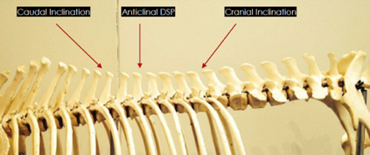
Introduction
'Kissing Spines’ represent the most common cause of thoracolumbar pain in TBs (Jeffcott, 1980; Zimmerman et. al, 2012)
Presents as poor performance related to back pain; welfare implication (Clayton et al, 2016)
Anatomy
Dorsal spinous processes
Soft tissue attachments - Interspinous
Most commonly affects mid-to-caudal thoracic region (Denoix et al, 2011)
Anticlinal vertebrae ‘0’
Economic impact- UK Racing £4bn annually (The Thoroughbred Breeders’ Association, 2023
Impact on performance on racehorses
Notes:
‘Kissing spines’ occur when the tips of the bony projections of the spine overlap or become impinged and are a common cause of thoracolumbar pain in thoroughbreds in the UK. A study by Zimmerman, Dyson and Murray (2012) found 76% of thoroughbreds with this condition to be afflicted with back pain. The flexion and extension of the spine due to the high usage of this breed in disciplines such as showjumping, racing etc. may contribute to the high prevalence.
Presents as poor performance. Clinical signs attributed to this condition are poor jumping, HL lameness, back pain, reluctance to be saddled and bucking. As the horses are in pain, it is necessary to consider the welfare implications of this condition.
The bony projections from the back are known as dorsal spinous processes, and in the horses, there are 18 thoracic and 6 lumbar, i.e. the region under the saddle. The interspinous ligaments lie between the individual DSPs, lending support and stability. In the lower anatomical specimen, the horses' head is to your left. The spinous processes are angled backwards close to the head, (caudally inclined) with the angle changing as you move backwards. So that they lean forwards (cranially inclined) At one point, marked by the middle arrow, the spinous process is vertical, known as the ‘anticlinal vertebrae’,. We have denoted it as ‘0’.
The UK racing industry is valued at 4billion annually to the UK economy. Any condition leading to poor performance or days out of training / retirement will have a negative impact to the industry. But perhaps more importantly, this condition presents as a major contributor to reduced welfare in racing and retired thoroughbred racehorses, any may limit potential for a 2nd career as a riding horse.

Slide 3
Current Surgical Techniques
Cranial wedge ostectomy (removal of wedge from front of bone) (Jacklin et al, 2014)
Interspinous ligament desmotomy (transection of ligament between ‘kissing spines’) (Coomer et al, 2012)
Overall prognosis after surgical treatment good to excellent (Walmsley et al, 2002)
Most common technique for severe cases - cranial wedge ostectomy (Jacklin et al, 2014)
Complications of cranial wedge ostectomy include: (Rubio-Martinez, 2021)
Vertebral fractures
Removal of excess bone
Never Ending Cuts (NECs)
Modified Image from Jacklin et al (2014) – Never Ending Cuts (NECs)
Notes:
This condition often requires surgical treatment. Surgical treatment provides the best long-term prognosis for this condition. A study by Walmsley et al in 2002 reported good success rate in 215 horses, with 72% returning to full work.
The 2 techniques used currently for treatment of this condition are cranial wedge ostectomy and interspinous ligament desmotomy.
Cranial wedge ostectomy involves the removal of a wedge of bone from the front of the dorsal spinous process and is used more commonly for more severe cases.
Reported complication following cranial wedge ostectomy includes fracture of the DSP, precipitated by removal of excess bone or inaccurately positioned cuts: a never-ending cut (NEC)
Never-Ending Cuts are regarded as surgical errors. These occur when a cut is performed, and you are unable to emerge cleanly between adjacent vertebrae. The occurrence of NECs can lead to undue surgical trauma, excessive bone removal and weakening of the remaining DSP, thus predisposing to fracture.
These x-rays were obtained before and after cranial wedge ostectomy. These modified images are from a publication by Jacklin et al. In the pre-op x-ray, there is evidence of ‘kissing spines’. In the post-op x-ray, there are 3 NECs with the one on the left showing small fracture fragment. This could potentially predispose to fracture of the DSP.

Slide 4
Study Aims and Hypothesis
Aims
Compare ‘exit angle’ of proposed ostectomy cuts for cranial and caudal wedge ostectomies
Compare area of bone removed for proposed cranial and caudal wedge ostectomies
Compare occurrence of NECs when surgical error is considered
Hypotheses
For caudally inclined kissing spines, a caudal wedge ostectomy would…
Reduced area of bone removed
Reduced risk of NECs
The exit angle closer to 90º than cranial wedge ostectomy
Notes:
Although the most common method used for surgical treatment is cranial wedge ostectomy, the aim of this investigation was to determine if an alternative technique may lead to the removal of less bone and reduce the risk of NECs. The alternative technique was rather than taking wedge of bone cranial, we investigated the removal of a wedge of bone from the caudal aspect.
This involved investigating if less bone was removed with a caudal wedge ostectomy compared to cranial wedge ostectomy, and if the occurrence of NECs would be lower for caudal wedge ostectomy compared to cranial wedge ostectomy.
As a measure for the margin of surgical error we also measured the ‘exit angle’ of the proposed ostectomy cut.
The hypotheses were, for the use of caudal wedge ostectomy in the caudally inclined DSPs (REMINDER – towards the tail, pointing backwards)
‘Exit angle’, means we are exiting either from the front or back surface of the DSP at a safer angle with the ostectomy.

Slide 5
Materials and Methods
Methods
Radiographs stitched together and degree of impingement graded (0-7) for 4 interspinous spaces in front and behind ‘0’
Proposed ‘ideal cuts’ for cranial and caudal wedge ostectomies were drawn by specialist surgeon
Measurements – area and ‘exit angle’
12º error cuts applied to simulate surgical error
Occurrence of NECs recorded
Data distribution assessed for normality
Statistical significance of differences between individual and groups of interspinous spaces calculated with statistical software
Included
Excluded
Horses included that had radiographic examination of thoracolumbar region
Absence of ‘kissing spines’, or inadequate radiographic detail
TBs presented to Philip Leverhulme Equine Hospital for investigation of poor performance or thoracolumbar pain
Subjects
Notes:
Radiographs collected from November 2015 to June 2023 from thoroughbreds that presented to Philip Leverhulme Equine Hospital, University of Liverpool for further investigation of signs of thoracolumbar pain and poor performance. 22 thoroughbreds were included in this study. Cases were excluded due to absence of ‘kissing spines’ on radiography or inadequate radiographic detail.
Radiographs were stitched together which allowed identification and labelling of the anticlinal vertebrae and corresponding interspinous spaces. The degree of impingement or severity of ‘kissing spines’ was graded on a scale of 0-7.
Ostectomy cuts were drawn on the x-ray to mimic an ‘ideal cut’ by a specialist surgeon. These proposed ostectomy cuts were drawn to fulfil the following criteria: to remove as little bone as is necessary creating a minimum of a 5mm gap between DSPs
Cuts with a proposed surgical error of 12º were then also drawn to account for the possibility of intra-operative errors. A proposed surgical error of 12º was selected because this was the average angle of ostectomy resulting in NEC from the paper the x-rays already shown.
Measurements taken included area of bone removed and ‘exit angles’.
Data distribution was then assessed for normalityusing visual methods (histograms with normal curves and QQ plots) and Kolmogorov-Smirnov and Shapiro-Wilk tests . Statistical software was used to determine the significance between individual and groups of interspinous spaces. Areas, exit angles and NECS were compared for caudally inclined and cranially DSPs using Wilcoxon rank sum tests.
The School of Veterinary Science ethical committee approved this study

Slide 6
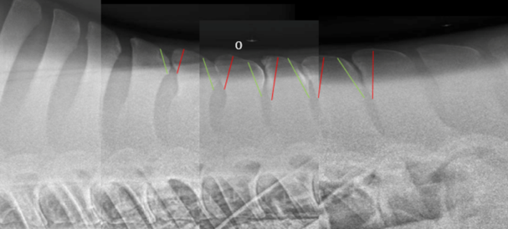
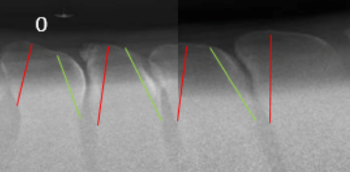
‘0’ – anticlinal vertebrae
-4
-3
+4
-2
-1
+1
+2
+3
Red = Cranial wedge ostectomy cuts
Green = Caudal wedge ostectomy cuts
Caudally inclined
Cranially inclined
Notes:
Here is an example of a case – several radiographs are stitched together. ‘0’ denotes the anticlinal DSP. Cranial to this interspinous spaces are labeled -4 to -1 (caudally inclined DSPs). Caudal to ‘0’, the interspinous spaces are labelel+1 to +4 (cranially inclined DSPs).
For sites of impingement (kissing spines) ideal ostectomy cuts have been drawn. Proposed caudal wedge ostectomies are drawn in green and cranial wedge ostectomies are drawn in red.
The areas of the bone removed is the wedge delimited by the red / green line.

Slide 7
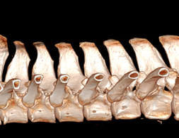
Materials and Methods Part B:
Experimental Cadaveric Study
Caudal wedge ostectomy performed on 2 cadavers to assess feasibility
CT pre- and postoperatively
CT
Notes:
The second stage of this study involved the application of caudal wedge ostectomy to cadavers. The aim of this stage was to assess the feasibility of the proposed technique and to identify potential technical issues
CT was used to critique the technique postoperatively.
In the lower left photograph, there is a prepared cadaveric specimen prepared for surgery on the CT table. In image on top right. DSPs have been dissected and are ready for ostectomy. I was thrilled to have the opportunity to actively participate in the surgeries and was involved in retracting tissue so ostectomy could be performed (upper left).

Slide 8
Results: ‘Kissing Spine’ Grading
Graded 0 to 7
+1 and +2 most frequently had highest grade of impingement
Correlates with previous literature
(Clayton and Stubbs, 2016)
N: 22 horses
120 impinging ‘kissing spines’ – 42.5% in caudally inclined and 57.5% in cranially inclined
Notes:
22 horses were included in the study of which there were 120 impinging spinous process (kissing spines) within the target area from interspinous space -4 to +4. Individual DSPs were graded on a scale of 0-7
The following graph shows the overall frequency in which each DSP had the highest grade for each case. DSP +1 and +2 (i.e. had a cranial inclination) most frequently had the highest grade. It is visible that the most commonly affected sites in this study were the mid-to-caudal thoracic DSPs. The location of these results correlates well to other previous studies.

Slide 9
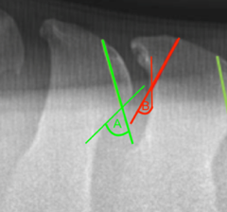
Results: Area and Exit angle
Area
Mean area significantly lower for caudal vs cranial wedge ostectomies for both cranially and caudally inclined DSPs (p < 0.001)
Exit Angles
Median difference from 90º significantly lower when using caudal vs cranial ostectomy for both cranially and caudally inclined groups (P < 0.001)
A – Exit angle for caudal ostectomy
B – Exit angle for cranial ostectomy
Notes:
The results of this study show favourable results for use of caudal wedge ostectomy
Exit angles:
• The median difference from 90º was significantly lower when using caudal wedge ostectomy for both cranially and caudally inclined groups compared to cranial wedge ostectomy
Area:
• The mean area ratios were also significantly lower using caudal wedge ostectomy across both groups in comparison to cranial wedge.

Slide 10
Results: Occurrence of NECs
Significantly reduced number of NECs using caudal wedge ostectomy vs cranial wedge ostectomy for caudally inclined ‘kissing spines’ (p < 0.001)
No significant difference in number of NECs using caudal wedge vs cranial wedge for cranially inclined ‘kissing spines’
-4 to -1 ‘kissing spines’
+1 to +4 ‘kissing spines’
Notes:
The number of NECs found across cranially vs caudally inclined vertebrae was compared when using a cranial and caudal wedge.
The results show that the use of a caudal wedge produced significantly reduced number of NECs than the use of a cranial wedge in caudally inclined. However, no significant difference was encountered using caudal vs cranial wedge for cranially inclined ‘kissing spines’

Slide 11
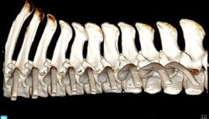
Discussion
Findings:
Smaller area of bone removed using caudal wedge ostectomy vs cranial wedge ostectomy – remaining DSP is stronger
Exit angle is more favorable for caudal wedge ostectomy and potentially this allows room for some deviation in ostectomy angle
Following hypothetical 12⁰ error, NECS were reduced in the the caudally inclined DSPs
Surgical technique feasible in practical setting
Highlights the importance of presurgical planning for any ostectomy
Notes:
The results for this study show that caudally wedge ostectomy produced favourable results, namely:
Removal of smaller amounts of bone – allowing stronger remaining DSPs, and thus reducing the risk of vertebral fractures
More favourable exit angle
Reduction in the incidence of NECs in the proposed 12º errors in caudally inclined DSPs, accounting for the possibility of intraoperative errors
Surgical technique was practically feasible
It is important that surgical treatment for this condition is as less invasive as possible to facilitate improved welfare, reduced rehabilitation times and subsequent economic benefits, lengthened second careers for retired racehorses and minimised risk of post-operative complications. And so, caudal wedge ostectomy may be considered in pre-surgical planning to reduce measures of surgical trauma and error.

Slide 12
Limitations and Future Applications
Limitations
Drawing of ‘ideal cuts’ may be influenced by surgeon bias
Area of the bone removed is a 2-dimensional measure and therefore may not reflect the volume of bone removed
Selection of 12⁰ error was based on only three NECs
Exit angle measured against often curving or irregular bone surface
Future Applications
Apply for ethical approval for a clinical trial assessing the technique in clinical cases
Notes:
Some limitations of this study included:
Drawing of the ‘ideal cuts’ is open to surgeon bias due to lack of objectivity in line placement. However, to aid in this limitation, the strict definition of ideal cut is as follows, ‘to remove as little bone as is necessary creating a minimum of a 5mm gap between DSPs’. Furthermore, if perceived as a major issue, the solution is to have several surgeons draw the ideal cuts and compare measures, calculating the interobserver agreement
The area was a 2D measure. Beyond the scope of this presentation, a larger scale study is currently being undertaken to compare the volume of CT to ensure these measures are correlated
Selection of a 12º error in this study was based on a selection of 3 cuts from a study by Jacklin, Minshall and Wight in 2014. Only 3 cuts were used to select this angle
Exit angle results may have been affected by the variable shape of the DSPs, namely the tendency for the surface to curve or be irregular
Going forwards, a point of future research would be to apply the technique in a clinical trial on horses affected with ‘Kissing Spines’

Slide 13
Conclusion
The results supported our a priori hypotheses
Hypothetical caudal wedge ostectomy resulted in improved surgical measures (safety and surgical trauma) compared to cranial wedge ostectomy in this experimental study based on thoracolumbar radiographs from Thoroughbreds with clinical signs of back pain
Notes:
The results of this study support all the hypotheses.
In conclusion, caudal wedge ostectomy produced favourable results to improve surgical measures based on x-rays of thoroughbreds with clinical signs of back pain. The improved surgical measures may confer safer surgical treatment and reduce incidence of surgical errors.

Slide 14
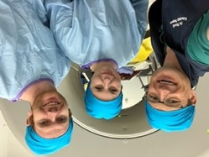
Acknowledgments
Acknowledgements
I very gratefully acknowledge Beaufort Cottage Educational Trust for sponsoring this project
Thank you to David Stack and Maurice Connaughton for their advice and guidance
Notes:
I am very grateful to the Beaufort Cottage Educational Trust for kindly sponsoring my summer studentship.
Additionally, many thanks to David Stack and Maurice Connaughton for all their advice and guidance whilst undertaking this research project.

Slide 15
References
Jeffcott, L.B. (1980), ‘Disorders of the thoracolumbar spine of the horse – a survey of 443 cases’, Equine Veterinary Journal, 12 pp. 197-210
URL: https://doi.org/10.1111/j.2042-3306.1980.tb03427.x,
Access Date: 13/12/2022
Zimmerman, M., Dyson, S., Murray, R., (2012), ‘Close impinging and overriding spinous processes in the thoracolumbar spine: The relationship between Radiological and Scintigraphic findings and clinical signs’, Equine Veterinary Journal, 44 pp. 178-184
URL: https://doi.org/10.1111/j.2042-3306.2011.00373.x
Access Date: 04/10/2022
Clayton, H.M., Stubbs, N.C. (2016) ‘Enthesophytosis and Impingement of the Dorsal Spinous Processes in the Equine Thoracolumbar Spine’, Journal of Veterinary Science, 47, pp. 9-15
URL: https://doi.org/10.1016/j.jevs.2016.07.015
Access date: 09/02/2023
Denoix J.M., Dyson, S.J. (2011) Diagnosis and management of lameness in the horse [edited by] Mike W. Ross, Sue J. Dyson, (Second Edition), W.B. Saunders, Chapter 52 – Thoracolumbar spine, pp. 592-605
ISBN: 9781416060697
Available at: https://doi.org/10.1016/B978-1-4160-6069-7.00052-3
Spoormakers, T.J.P., Veraa, S., Graat, E.A.M., van Weeren, P.R., Brommer, H. (2021), ‘A comparative study of breed differences in the anatomical configuration of the equine vertebral column’, Journal of Anatomy, 239(4) pp. 829-838
URL: https://doi.org/10.1111/joa.13456
Access date: 23/12/2022

Slide 16
References
The Thoroughbred Breeders’ Association (2023) Economic impact study of Britain’s thoroughbred breeding industry
URL: https://www.ifhaonline.org/resources/TBA-Economic-Impact-Study-2023-report.pdf
Access date: 25/07/2023
Jacklin, B.D., Minshall, G.J., Wright, I.M., (2014) ‘A new technique for subtotal (cranial wedge) ostectomy in the treatment of impinging/overriding spinous processes: description of technique and outcome of 25 cases’, Equine Veterinary Journal, 46(3) pp. 339-344
URL: https://doi.org/10.1111/evj.12215
Access date: 04/10/2022
Coomer, R.P.C., McKane, S.A., Smith, N., Vandeweerd, J.M.E. (2012), ‘A Controlled Study Evaluating a Novel Surgical Treatment for Kissing Spines in Standing Sedated Horses’, Veterinary Surgery, 41 pp. 890-897
URL: https://doi.org/10.1111/j.1532-950X.2012.01013.x
Access date: 19/12/2022
Walmsley J.P., Pettersson, H., Winberg, F., McEvoy, F. (2002) ‘Impingement of the dorsal spinous processes in two hundred and fifteen horses: case selection, surgical technique and results’, Equine Veterinary Journal, 34(1), pp.23-28
URL: https://doi.org/10.2746/042516402776181259
Access Data: 02/12/2023
Rubio-Martinez, L.M. (2021), Complications of Surgery for Impingement of Dorsal Spinous Processes. In Complications in Equine Surgery (eds L.M. Rubio-Martinez and D.A. Hendrickson)
URL: https://doi.org/10.1002/9781119190332.ch59
Access Date: 04/10/2022

