Slide 1
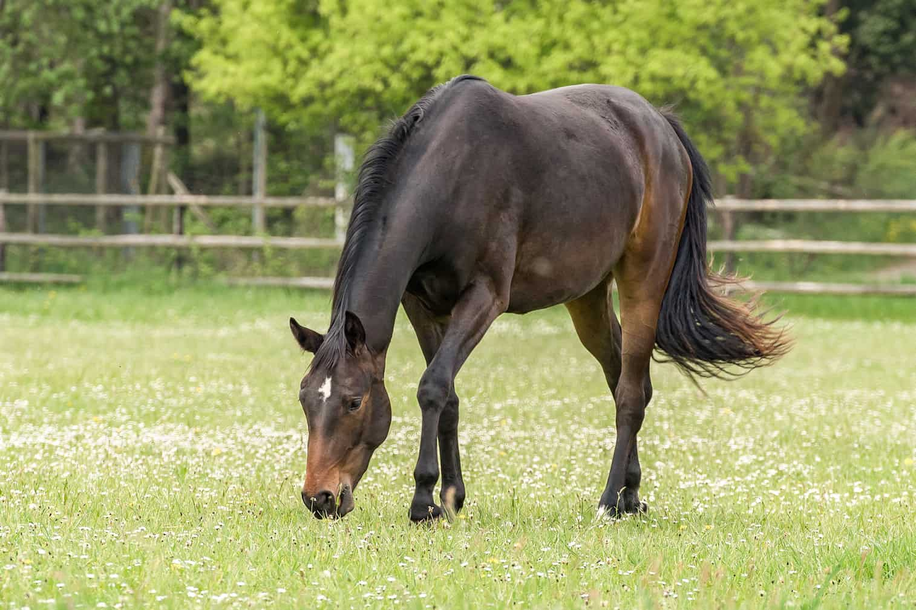
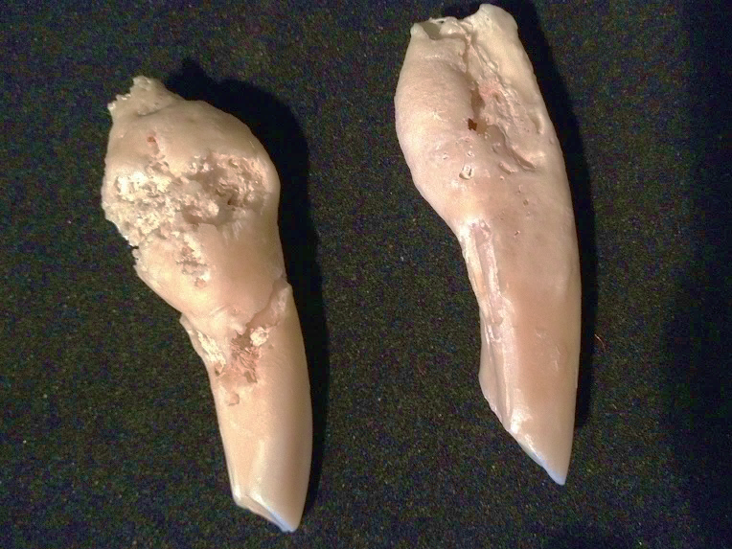
Investigation of the Biochemical Mechanisms associated with Equine Odontoclastic Tooth Resorption and Hypercementosis
Alex Wylie – Fourth year Veterinary Science Student
Supervisor: Prof. Mandy Peffers & Anders Jensen
Institute of Life Course and Medical Sciences,
Faculty of Health & Life Sciences
Notes:
Photo source - https://pferdezahnarzt.pro/wp-content/uploads/2015/09/praep.jpg

Slide 2
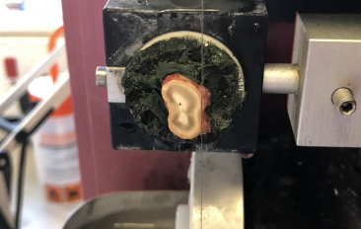
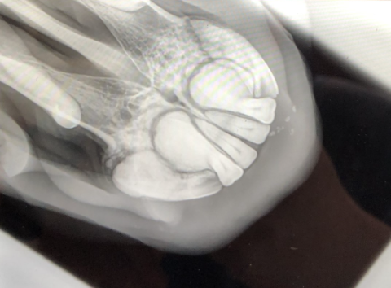
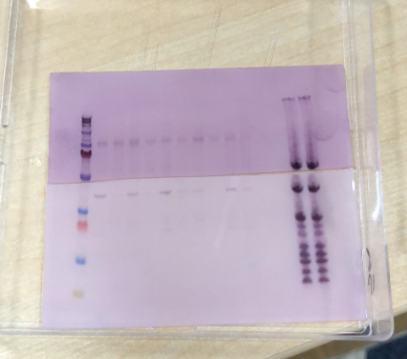
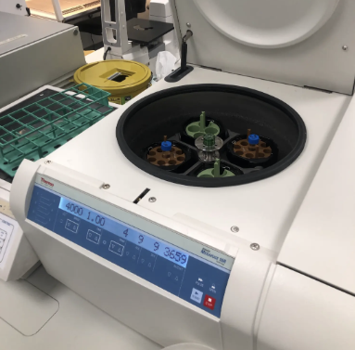
Contents
Introduction & Background
Aims
Methods
Results
Conclusion & Future Work
Acknowledgments
Notes:
Can talk about how I got the project, where I did it, what I did

Slide 3
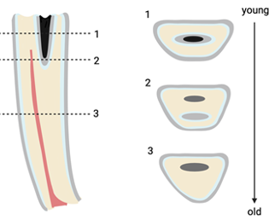
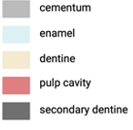
Background & Introduction
What is EOTRH?
An equine dental disease, primarily affecting the incisors of older horses (>15Y).
Main effects include resorptive lesions and significant hypercementosis (HC).
Importance of EORTH
Decline in welfare for the effected horses.
Severe pain, weight loss and negative behavioural changes develop as a result.
Unknown cause, although several ideas.
Current diagnosis
Clinical exam, supported by radiographs +/- post-extraction micro-CT findings of tooth
resorption and hypercementosis.
Current treatment
Primary treatment currently is surgical
extraction of affected incisors and
debridement of alveolar damage.
Healthy
Moderate
Severe
Severe (HC)
Progression of EOTRH in Equine Incisors. Radiographic images obtained from Northeast Equine Veterinary Dental Services.
Notes:
Unknown cause, 2004 first described-> 2008 termed EOTRH
mechanical strain to the periodontal ligament allowing bacteria to grow (change in size and angle of teeth in older horses)
gum inflammation
Bacteria
Owners notice huge bounce back in their horses after extraction
make sure to emphasise the images on the bottom right

Slide 4
Study Aims
Aim:
To quantify proteomic changes in tooth cementum between healthy ageing horses and EOTRH-affected horses.
To Enable:
Identification of the biological changes occurring in cementum.
Increase our understanding of the pathogenesis of EOTRH.
Notes:
Cementum affected but also periodontal ligament and other tissues

Slide 5
Methods
Isolation of Cementum
Protein Extraction
Proteomics Workflow
Data Analysis and Conclusion
Process Overview:
Obtain Teeth Following Extraction
Isolate Cementum From Diseased and Healthy Teeth
Run Proteomics
Extract Proteins Contained in Cementum
Modify Sample to Run Correctly for Proteomics
Notes:
2) Diseased ones have been determined by an equine dentist and tend to come from older horses to be sure. can also elaborate on this to say you used QLF-D to image them to look for clinical signs. Can also mention how microCT could be useful in determining this.

Slide 6
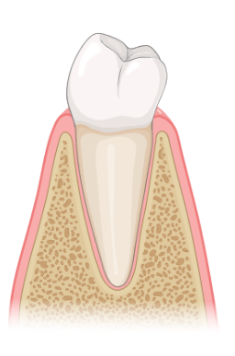
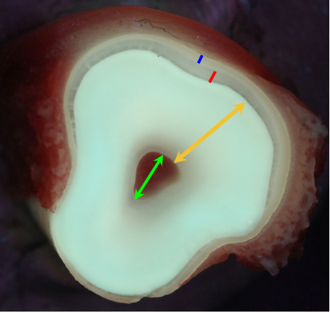
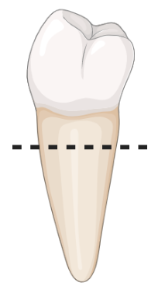
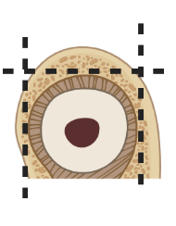
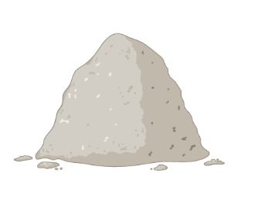
Methods
Isolation of Cementum
Protein Extraction
Proteomics Workflow
Data Analysis and Conclusion
Isolation of Cementum
QLF-D Image Of Equine Incisor
Tissue processing workflow
Remove adherent soft tissue from the outer surface of the tooth.
Alveolar bone is removed.
Horizontal cross section of tooth produced with diamond wire
Tissue identified with QLF-D.
Cut tooth with diamond wire to remove cementum.
Crush cementum into powder using mikro-dismembrator.
Adhering Teeth To Diamond Wire
Cementum, Enamel, Dentine, Pulp Cavity
Healthy
Diseased
Notes:
QLF = Quantitative light-induced fluorescence

Slide 7
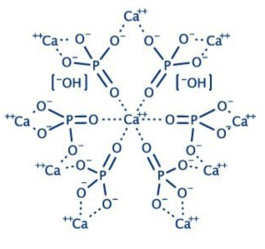
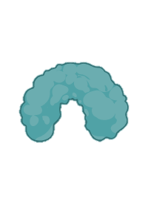
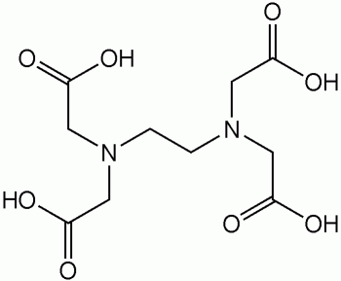
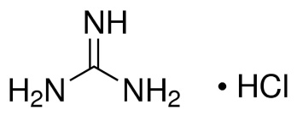
Methods
Isolation of Cementum
Protein Extraction
Proteomics Workflow
Data Analysis and Conclusion
Protein Extraction
1. Hydroxyapatite
2. Proteins interact with HAP
Mineral Content
Hard dental tissues consist of a complex organisation of minerals called hydroxyapatite.
Mineral-Protein Interaction
Proteins bind to HAP by forming strong hydrogen bonds with them.
This means proteins are difficult to solubilise.
EDTA and GnHCl Extraction
EDTA is a chelating compound, which removes minerals by forming strong bonds with them.
Guanidine Hydrochloride (GnHCl) is a chaotropic detergent used to solubilise proteins.
Chaotrope = able to break hydrogen bonds
3. EDTA
4. GnHCl
Notes:
Do not go into too much detail as people wont underdstand.
Hard to get proteins out of dental tissues because they are hard and insoluble. Why is this? They contain a mineral called hydroxyapatite.
The proteins we are interested in bind to these quite strongly so we need to remove them.
Therefore we use a chelating agent, to remove these minerals.
This then leaves our proteins free in the sample ready to be solubilised in guanidine hydrochloride.
This a fancy chemical which is very good at solubilising proteins.
The blue bits are proteins and the rods and hydroxyapatite./ “

Slide 8
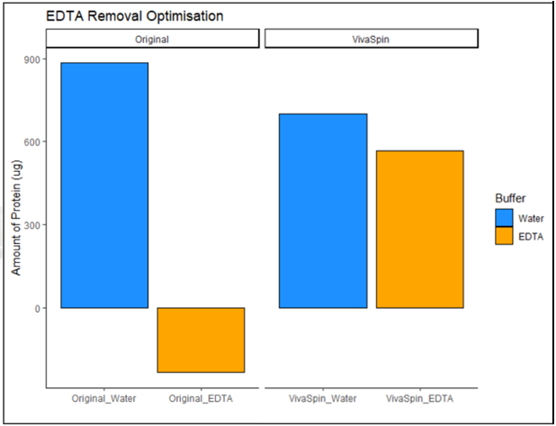
Methods
Isolation of Cementum
Protein Extraction
Proteomics Workflow
Data Analysis and Conclusion
Proteomics – Sample Clean-Up
Sample Clean-up
Determine protein concentration
The concentration of EDTA and GnHCl used are too high and will interfere with processing.
Must be removed via VivaSpin .
Protein
+ EDTA
+ GnHCl
EDTA + GnHCl
Protein
VivaSpin column
Graph to show the effects of EDTA on detecting protein in water
Notes:
EDTA ruins any biochemistry experiments you want to do so it needs removing
explain the image on the right is a troubleshooting experiments, the idea is that the amount of protein in water should stay the same

Slide 9
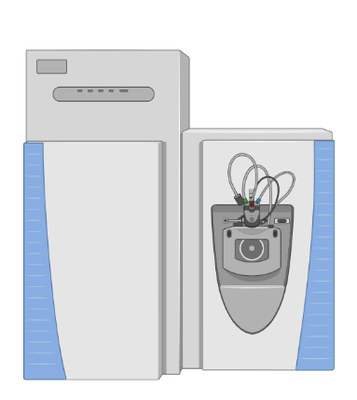
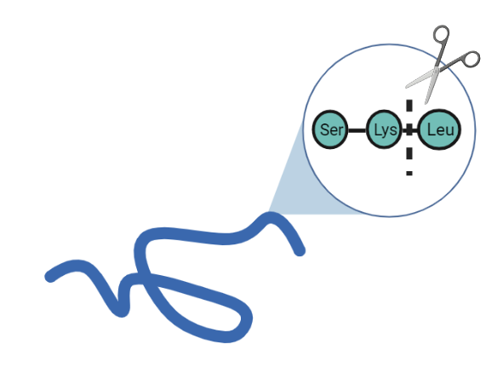
Methods
Isolation of Cementum
Protein Extraction
Proteomics Workflow
Data Analysis and Conclusion
Proteomics – Protein digestion
Protein Digestion
From proteins to peptides to proteins
Mass spectrometry uses the properties of peptides to identify the proteins in the solution (Mass/Charge).
Proteins are cleaved by trypsin to form peptides.
These peptides can then be analysed and mapped to the proteins they come from.
Cleaving of proteins via Trypsin
Mass spectrometer
Notes:
Split them into peptides, -> peptides make proteins.
Keep it simple, mass spec is a complex tool to tell us more about the overall protein profile of a given tissue/solution.
This can then tell us about how these tissues are behaving, is there inflammation? are the cells under stress? are there biological changes? ect.
To use this technique, we have to process our proteins to peptides (bricks of a house).

Slide 10
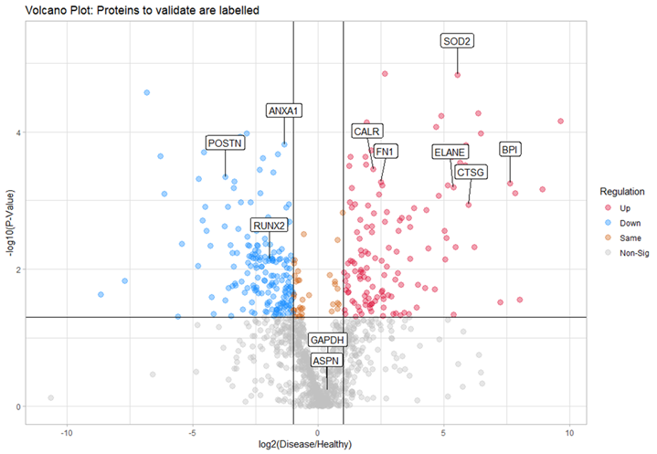
Results
Isolation of Cementum
Protein Extraction
Proteomics Workflow
Data Analysis and Conclusion
Elastase
Data Analysis and Conclusion
Annexin
Cathepsin-G
Findings
Periostin
BPI
We identified 1154 unique proteins across all 10 samples.
In EOTRH samples, 136 and 194 different proteins found to be up and down regulated, respectively. The remaining 824 proteins were either equally expressed, or up/down-regulation was non-significant.
Notably, neutrophil-expressed proteins such as Cathepsin-G, Elastase, Bactericidal permeability-increasing (BPI) protein were all up regulated in diseased teeth. Known biomarkers of periodontal disease, such as Superoxide Dismutase and Calreticulin were also up regulated in diseased teeth.
Markers of periodontal ligament (PDL), such as Annexin and Periostin were down regulated in disease, suggesting the loss of functional PDL attachment.
Volcano plot to show the upregulated and downregulated proteins
Notes:
Graph shows up and down regulated proteins, Further to the left/right = More downregulated/upregulated, Further to the top = lower p value/More significant -> more confidence
Vice versa with bottom.
What is significant? the answer is twice as high and with a p value below 0.05
Go through this slowly, make sure to say that there’s lots of differences and not entirely sure what most of it means.
Talk about what it means for neutrophil proteins to be up-regulated (i.e. they’re white blood cells, which may indicate an inflammatory response)
Really interestingly BPI is up-regulated which is a protein that is involved in the response to gram negative bacteria – this study …. https://pubmed.ncbi.nlm.nih.gov/23742079/
Found that gram negative bacteria such as Treponema and Tannerella are higher in eotrh. Interesting so maybe the symptoms are due to not only the bacteria but also the response to the bacteria and what effect that may have on the cells
Common set values for proteomics determines what is upregulated.

Slide 11
Results
Isolation of Cementum
Protein Extraction
Proteomics Workflow
Data Analysis and Conclusion
Data Analysis and Conclusion
Validation
Validation of the proteomic results is where things started to break down…
This was done using Western Blotting.
Proteins are separated by molecular weight using gel electrophoresis. The proteins are then stained with a specific antibody complementary to our protein of interest. This protein-antibody complex can then be identified via different methods.
We used 6 different proteins with corresponding antibodies
Western Blot didn’t work properly, and didn’t produce results that we were confident in.
Several reasons for this:
Non-horse, less specific antibodies used.
Concentration of antibody and/or protein used too low.
Western blots may not be the most appropriate technique for this experiment.
Notes:
6 diff proteins = Calreticulin, Fibronectin, Periostin, Neutrophil Elastase, Bactericidal PI, Cathepsin-G
BPI^^ (??) +/- GAPDH
Project was going really well, in terms of tooth processing, and the proteomics data, but only up until validation.
Just need to mention that it will take a bit of time to optimise all these things but could be done in the future.
Said that western blots may not be appropriate and someone may ask why. Can try ELISA or immunohistochemistry.
Western blot didn’t work properly, had a few problems
Western blot = looking for one protein rather than all the proteins

Slide 12
Conclusion & Future Work
During this experiment, we have shown a proteomic shift associated with EOTRH, providing us with a further insight into the development of the disease.
The up-regulation of inflammatory markers may indicate the observed symptoms are due to a response to bacteria found in EOTRH.
In future for EOTRH, more experiments could be carried out to further understand this reasonably unknown disease. A few ideas include characterising dental-derived stem cells in healthy ageing horses and EOTRH, investigating globally the types of bacteria in healthy ageing horses and EOTRH, Quantifying proteomics changes in other important cells and tissues of the tooth effected by EOTRH.

Slide 13
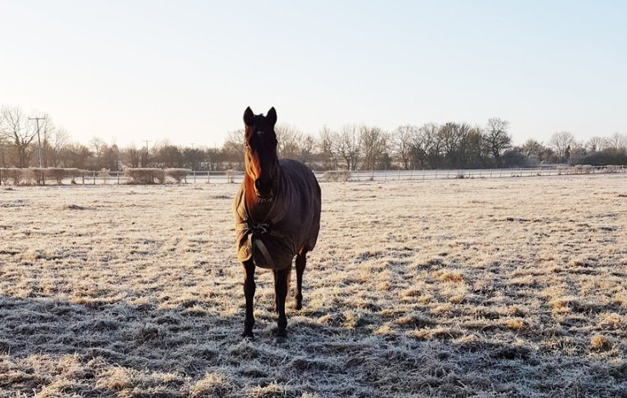
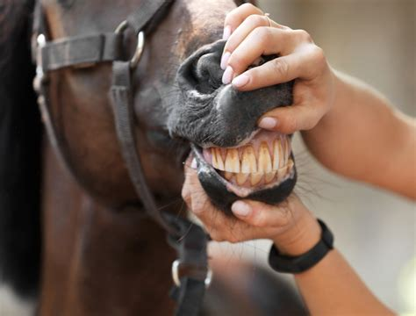
Acknowledgments
Thank you for listening!
Gerald Leigh Charitable Trust & Beaufort Cottage Educational Trust
For funding and organising this Summer Scholarship
University of Liverpool, Institute of Life Course and Medical Science
Prof. Mandy Peffers & Anders Jensen, for and providing unlimited help during the project. Lisa Aldag-Caparrelli for being a great lab partner
North Wales Equine Dental Practice
Dr. Andy Peffers, allowing me to observe incisor extractions and provide diseased samples
University of Liverpool Dental School Research Wing
Lee Cooper, for allowing the use of his dental lab and equipment

