Slide 1
Development of a non-invasive diagnostic test for dual detection of fetal aneuploidy and fetal sex in the pregnant mare
Dr Anne Kahler
Equine Pregnancy Laboratory – Mandi de Mestre & Madeleine Campbell
Royal Veterinary College London

Slide 2
NIPT in women
a screening test for fetal genetic abnormalities
based on isolation of cell-free fetal DNA (cffDNA) from maternal blood
= non-invasive
cfDNA
small pieces of DNA, with a very short lifespan
released during cell death and via secretion of microparticles from all tissues of the body
applied as a diagnostic biomarker
in pregnancy, fetal cfDNA originates from the placenta

Slide 3
What are the proposed benefits of NIPT in equine stud medicine?
(a) Incidence of pregnancy loss.
d15-42
6.4%
d43-65 1.6%
d65 to birth
5.5%
approx. 80% of pregnancies result in a live foal
d0-14
(b) Diagnosis of pregnancy loss.
aneuploidy presents in approx. 22% of failed equine pregnancies
specific lethal genetic variants are known, e.g., mutation of the PLOD1 and deletion of the TUBB gene, or expected be discovered in the future
… approx. 60% of pregnancy losses in mares do not receive a diagnosis

Slide 4
Equine NIPT may offer a diagnostic tool …
to diagnose aneuploid pregnancies & lethal genetic variants
to unravel unexplained pregnancy loss
to allow non-invasive sex determination of the fetus
Goal: to add “a piece to the puzzle” of pregnancy monitoring, counselling & informed management of mares suffering pregnancy loss.

Slide 5
1st hurdle – can we find cfDNA ??
sparse knowledge and no established techniques for isolation and assessment of cfDNA in horses
guidance via methodologies, applied in human medicine
plasma samples
pregnant mares
non-pregnant mares
geldings
d70 to 80
n = 6
last trimester
n = 15

Slide 6
Results – cfDNA Isolation I
cfDNA isolations n = 80
median cfDNA yield 0.99 ng/ml plasma
cfDNA yield is not different (P > 0.05) between
individual mares
stage of pregnancy
plasma volume/isolation
processing of plasma within 12h vs 24h from blood collection
*
Fig. (a) cfDNA yield (ng/ml plasma)
*Bayless et al, 2022, median cfDNA concentrations

Slide 7
Results – cfDNA Isolation II
cfDNA yield (ng/ml) is significantly higher (P = 0.0037) for an incubation temperature of
56°C (Incubation temperature 1, n = 40) compared to
21°C (Incubation temperature 2, n = 40)
during the magnetic-bead binding step of the isolation protocol
21°C
56°C

Slide 8
2nd hurdle – is there a fetal contribution to the small amount of total cfDNA isolated from pregnant mares’ plasma ??
false “positive” and false “negative” NIPT results are possible and described for human pregnancies
confidence of any NIPT highly depends on the “fetal fraction”
Goal: to examine presence of fetal cfDNA via detection of a male “signal” by qPCR.

Slide 9
A cffDNA sexing qPCR must …
.. amplify cell- free DNA
.. be very sensitive & specific
.. amplify fetal DNA

Slide 10
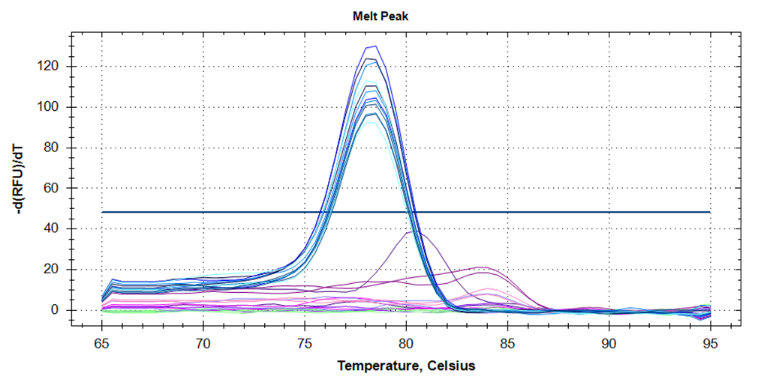
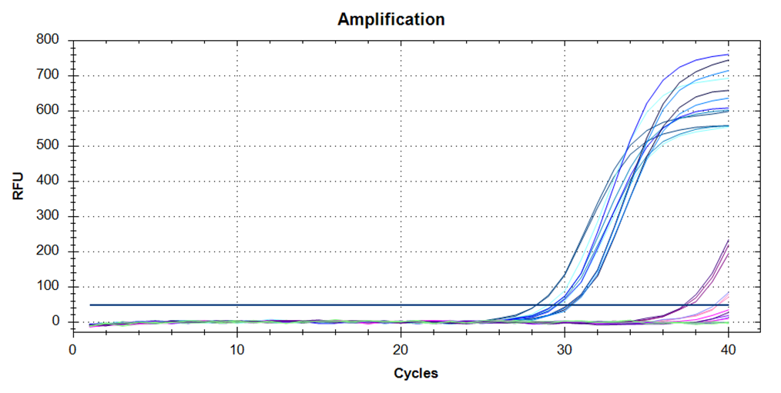
qPCR – ADULT CONTROL DNA I
use of a novel Y – chromosomal marker “TSPY”, present in multiple copies
primers designed for a product size of 75 bp
male specific amplification
female non-specific amplification
Representative images of melt peak & amplification curves for DNA, isolated from blood/tissue of adult horses.

Slide 11
qPCR – ADULT CONTROL DNA II
template DNA | 0.2ng | 0.1ng
Valid, conclusive & correct | 39/41 | 33/41
Non-valid | 0/41 | 2/41
Inconclusive | 2/41 | 5/41
Incorrect | 0/41 | 1/41
Effectiveness* | 95.1% | 80.5%
Sensitivity | 100% | 100%
Specificity | 100% | 95.2%
Pos Predictive Value | 100% | 92.8%
Neg Predictive Value | 100% | 100%
*Effectiveness (%) = valid, conclusive & correct classifications/total no. of samples (n = 41).

Slide 12
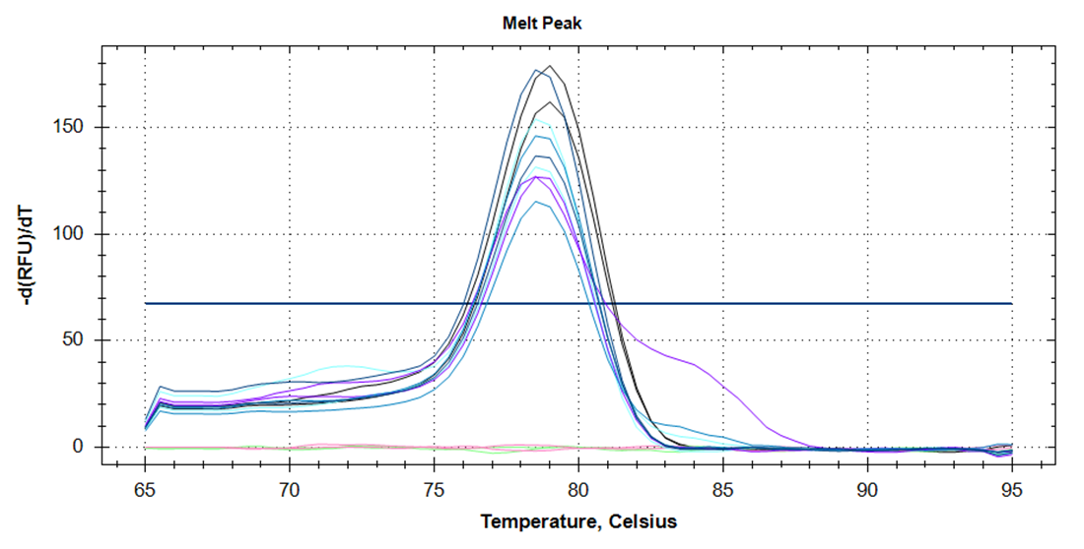
qPCR – ADULT CONTROL DNA III
male control
10% male
4% male
8% male
6% male
pooled female
NTC
Cell-free DNA isolated during pregnancy always consists of a larger maternal and smaller fetal fraction. A fetal fraction of approx. 4% is required to achieve conclusive NIPT in women.
4% to 10% of male DNA, added to an “artificial female DNA sample”, is reliably detected.

Slide 13
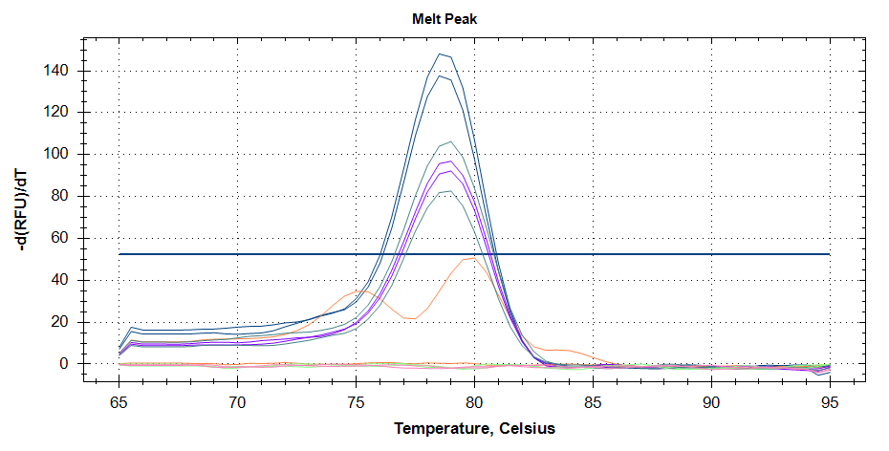
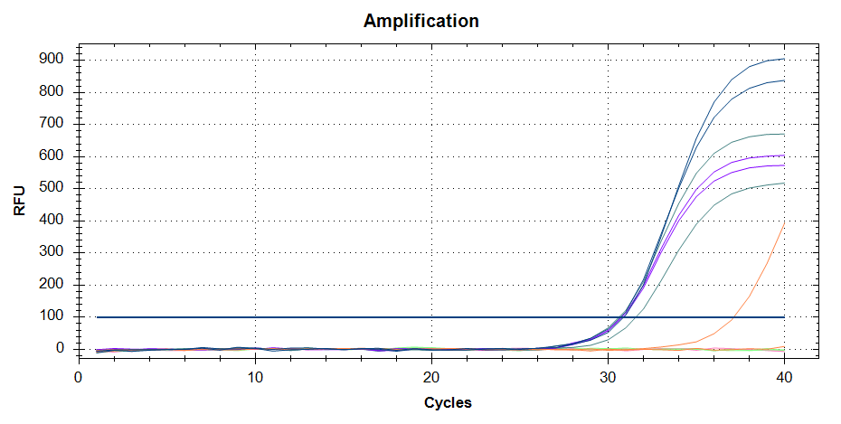
qPCR – FETAL DNA
male control
male ALC
male ALC
female ALC
female control
NTC
Conclusive results present for 6/6 samples of DNA, isolated from early fetal membranes (d33 to 42 of pregnancy).

Slide 14
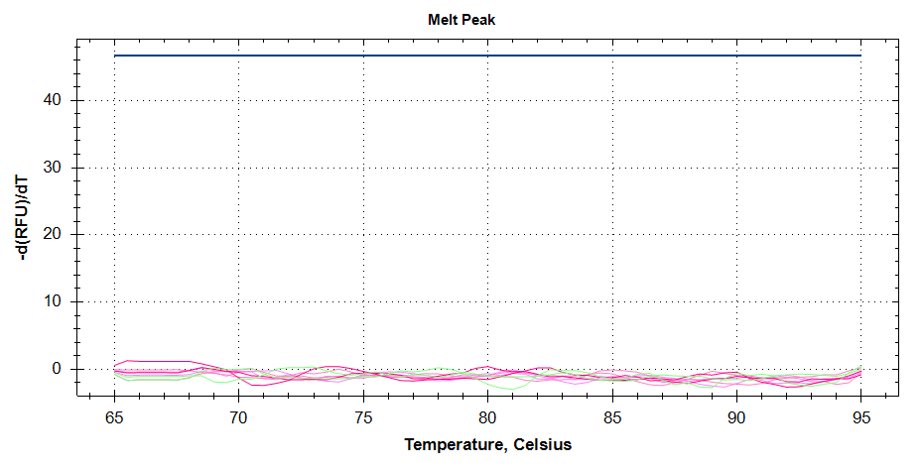
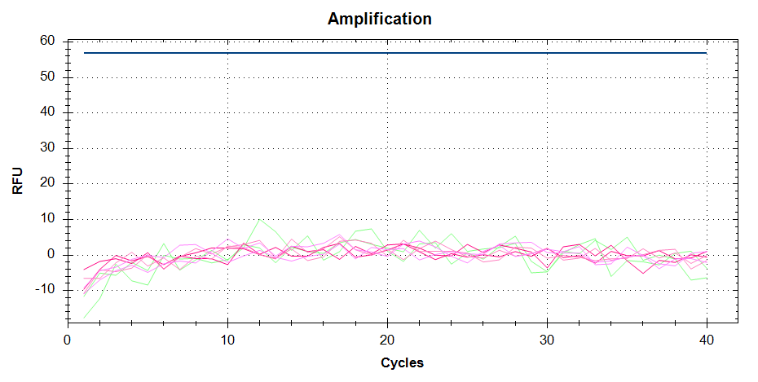
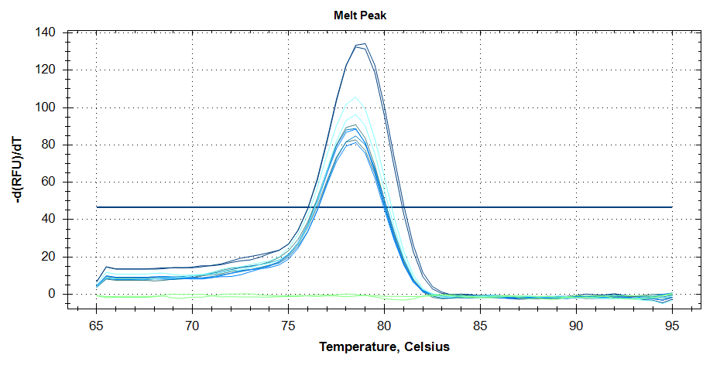
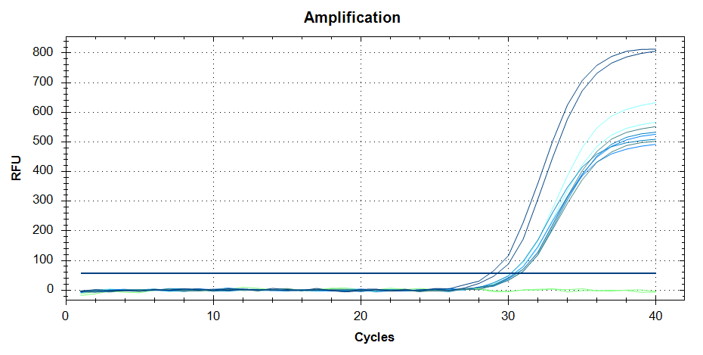
qPCR – adult cfDNA (0.1 to 0.4 ng template DNA)
(a) Images of TSPY melt peak & amplification curves for cfDNA, isolated from plasma of non-pregnant adult mares (n = 2).
(b) Images of TSPY melt peak & amplification curves for cfDNA, isolated from plasma of adult geldings (n = 4).

Slide 15
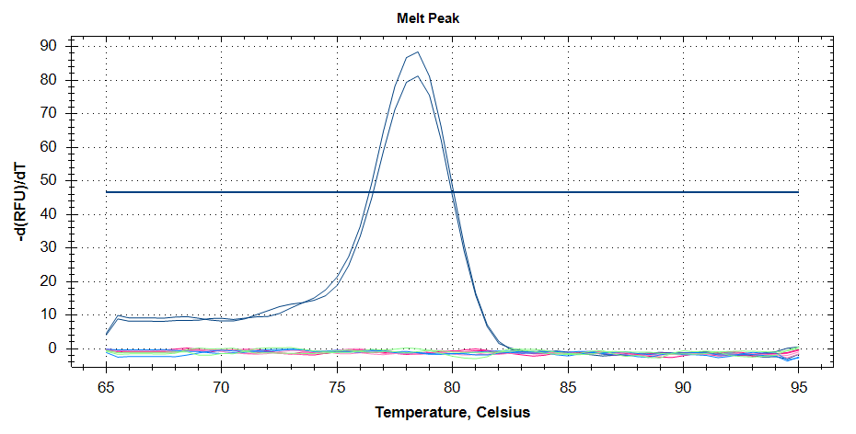
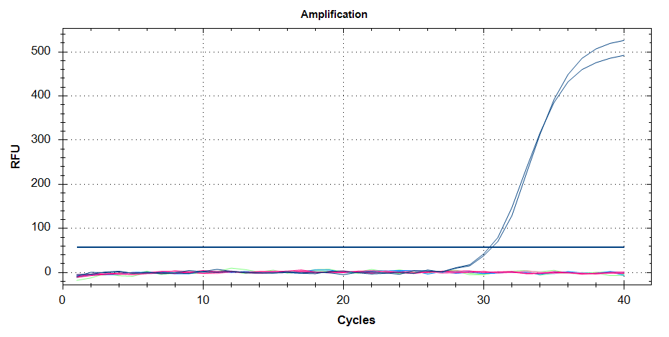
qPCR – fetal cfDNA (0.1 to 0.4 ng template DNA)
cf male control
Representative images of TSPY melt peak & amplification curves for cfDNA, isolated from plasma of pregnant mares, one carrying a male and one a female pregnancy and cfDNA isolated from plasma of a non-pregnant mare (female control) and a gelding (male control).
Amplification of TSPY for cfDNA, isolated from plasma of pregnant mares:
 | d70 - 80 | last trimester
Inconclusive | 0/6 | 1/15
Conclusive | 6/6 | 14/15
BUT | 2/2 | 4/4
confirmed male pregnancies predicted as females = false negative.

Slide 16
Conclusion
first detailed description of isolation & assessment of cfDNA from plasma of pregnant mares
development of a sexing qPCR, that is highly sensitive, specific and amplifies adult, fetal & cfDNA
although a male signal from cfDNA, isolated from plasma of mares, carrying a male pregnancy – indicating the fetal fraction – was not detectable
fetal fraction ?
plasma volume & composition ?
equine placentation ?

Slide 17
Thank you.
Rossdales Veterinary Surgeons
Newmarket Equine Hospital
Twemlows Stud farm
St Georges University of London
Equine Pregnancy Laboratory
Mandi de Mestre & Madeleine Campbell

Slide 18
References
Incidence and causes of pregnancy loss after Day 70 of gestation in Thoroughbreds. Roach JM, Foote AK, Smith KC, Verheyen KL, de Mestre AM. Equine Vet J. 2021 Sep;53(5):996-1003. doi: 10.1111/evj.13386.
Descriptive study of current therapeutic practices, clinical reproductive findings and incidence of pregnancy loss in intensively managed thoroughbred mares. Rose BV, Firth M, Morris B, Roach JM, Wathes DC, Verheyen KLP, de Mestre AM. Anim Reprod Sci. 2018 Jan;188:74-84. doi: 10.1016/j.anireprosci.2017.11.011.
Whole genome analysis reveals aneuploidies in early pregnancy loss in the horse. Charlotte A Shilton, Anne Kahler, Brian W Davis, James R Crabtree, James Crowhurst, Andrew J McGladdery, D Claire Wathes, Terje Raudsepp, Amanda M de Mestre. Sci Rep. 2020 Aug 7;10(1):13314. doi: 10.1038/s41598-020-69967-z
Fetal morphological features and abnormalities associated with equine early pregnancy loss. Kahler A, McGonnell IM, Smart H, Kowalski AA, Smith KC, Wathes DC, de Mestre AM. Equine Vet J. 2021 May;53(3):530-541. doi: 10.1111/evj.13340.
Skin malformations in a neonatal foal tested homozygous positive for Warmblood Fragile Foal Syndrome. Monthoux, C., de Brot, S., Jackson, M. et al. BMC Vet Res 11, 12 (2015). https://doi.org/10.1186/s12917-015-0318-8
First reported case of fragile foal syndrome type 1 in the Thoroughbred caused by PLOD1 c.2032G>A. Grillos AS, Roach JM, de Mestre AM, Foote AK, Kinglsey NB, Mienaltowski MJ, Bellone RR. Equine Vet J. 2022 Nov;54(6):1086-1093. doi: 10.1111/evj.13547.

