Slide 1
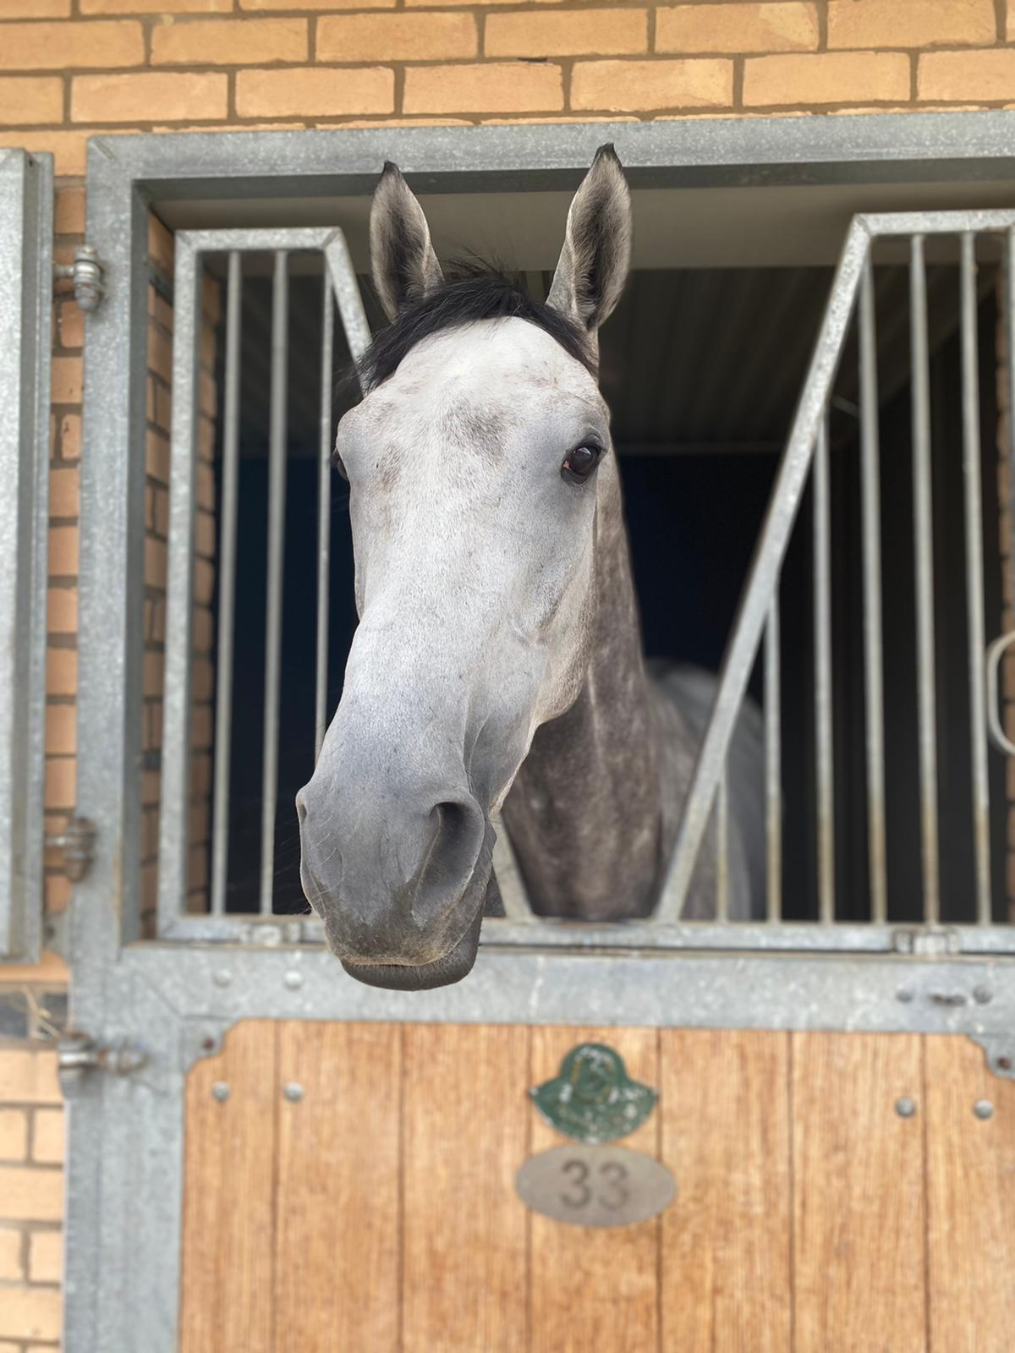
Biosecurity on Thoroughbred Racing and Training Premises in the UK
Alice Webb – Fourth year BVSc student
Supervisor: Prof Debra Archer
Department of Equine Clinical Sciences, School of Veterinary Sciences, University of Liverpool.

Slide 2
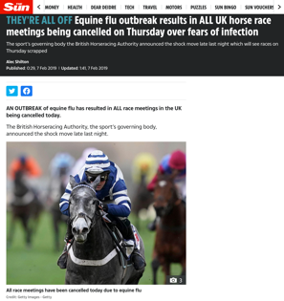
Introduction
The 2019 UK equine influenza outbreak demonstrated the major economic and welfare impact that infectious diseases pose to the equestrian industry, including Thoroughbred (Tb)racing
Biosecurity practices and attitudes are a major factor in spread and control of disease outbreaks
2007 Equine Influenza outbreak in Australia (Schemann et al. 2012)
Transport of equids, climate change and spread of insect vectors are also factors that increase the risk for entry and transmission of new diseases into the UK
African Horse Sickness and West Nile Virus (Robin et al. 2016, Chapmen et al. 2018).

Slide 3
Study Aims
To investigate current biosecurity practices on Thoroughbred racing premises and racecourses.
1. Identify areas of good practice that can be shared within the industry
2. Identify areas where biosecurity could be improved to minimise the risk of introduction and spread of equine infectious diseases.

Slide 4
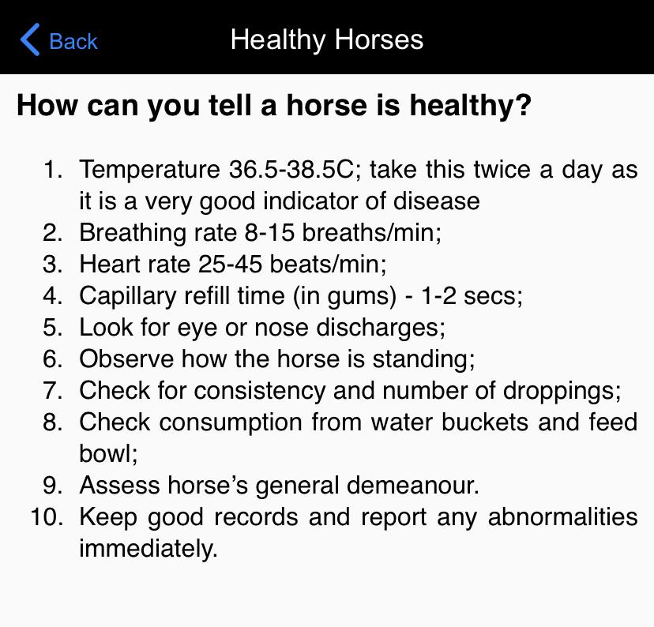
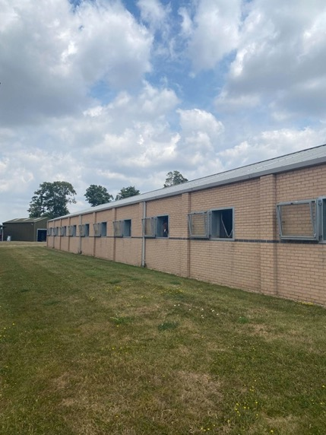
Phase 1 - questionnaire
Online questionnaire designed and piloted (separate one for racehorse premises and racecourse)
BHA guidelines, Biosafe app, Expert opinion
4 sections covering:
General information – type of premises, concern around particular diseases
Yard Routine
Disease prevention
Attitudes to biosecurity
Ethical approval obtained from UoL Veterinary Research Ethics Committee

Slide 5
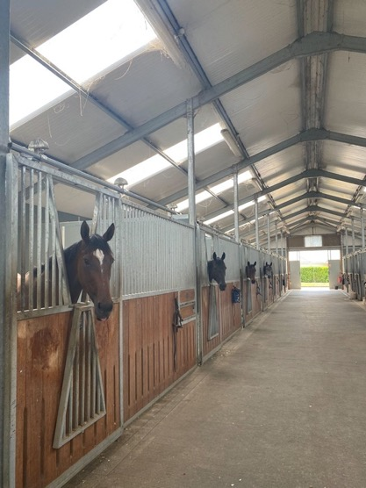
Phase 1 - questionnaire
All UK Tb racecourses and licenced Tb racehorse trainers contacted by email and asked if they or a nominated member of staff would be willing to complete an online survey about biosecurity practices taken on their premises.
Permit trainers not contacted as there are no publicly available lists of these
Concern around lack of potential engagement by racehorse trainers
Incentive to participate by offering entry for those who completed the questionnaire into a prize draw to win £100, £50 and £25 Amazon voucher
Data analysed using descriptive statistics

Slide 6
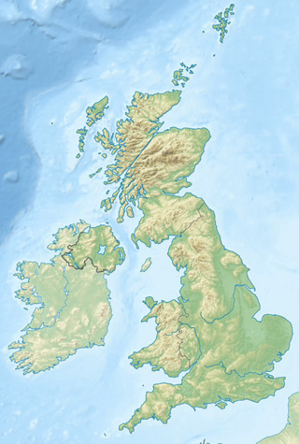
Phase 2 – site visits
4 racecourses and 6 TB trainers yards in 2 main geographic areas (NW UK and SE UK including Newmarket) identified and asked if they would be willing for a short site visit
Mixture of types of training yards
Structured site visit to directly assess the premises including stable materials, disinfectants on the premises and practical biosecurity measures e.g. handwashing facilities for personnel.
Themes generated based on site visit interviews
Red = racehorse trainers, Blue = racecourses

Slide 7
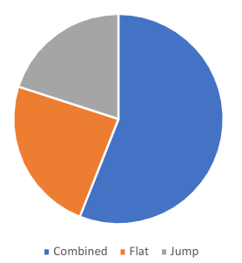
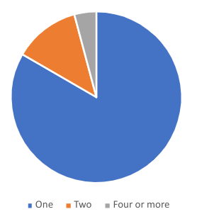
Results – racehorse trainers
Types of racing yards
Number of premises
538 racehorse trainers contacted by email
25 completed questionnaire
Response rate = 4.6%
Completed by:
Trainers 68% (n=14)
Assistant trainers = 24% (n=6)
Head yard person = 4% (n=1)
Racing secretary = 4% (n=1)
20%
54%
24%
4.2%
12.5%
83.3%
Notes:
54% (n=14/25) combined (flat and jump) 24% (n=6/25) flat 20% (n=5/20) jump one premises (83.3%, n=20/24) Two premises12.5% (n=3/24) keeping horses two premises, and 4.2% (n=1/24) using 4 or more premises.

Slide 8
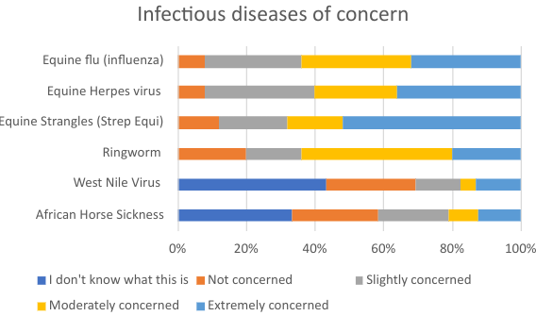
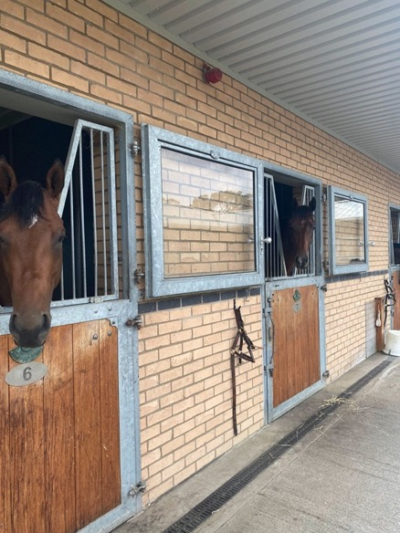
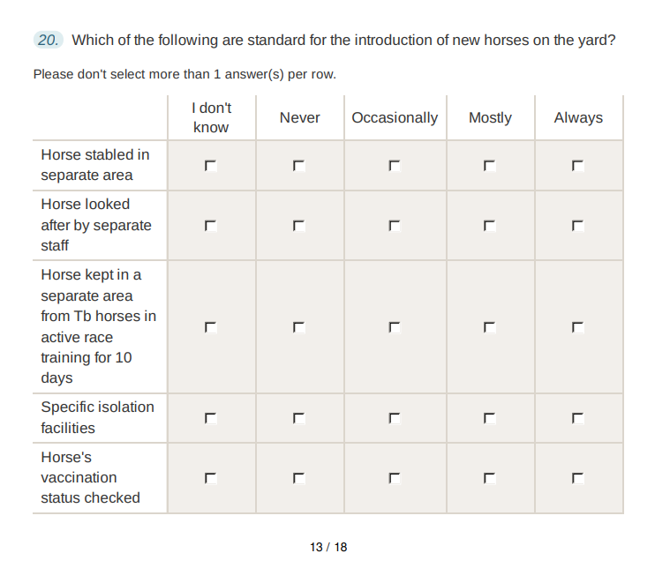
Results – racehorse trainers
High levels of concern for Ringworm, Equine influenza, Equine Herpes virus and Equine Strangles
Trainers had a low awareness of West Nile Virus and African Horse Sickness
Comments were made about particular areas of concern including:
horses arriving from other yards
contact at sales
shared airspace
using racecourse stables

Slide 9
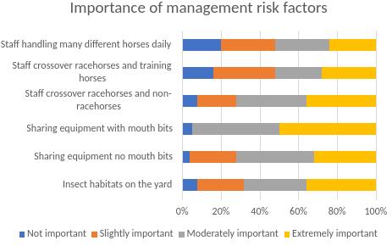
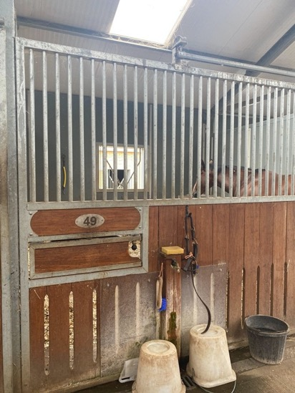
Results – racehorse trainers
Sharing of equipment with mouth bits considered the most important risk factor for spread of disease
Concerns around tack being responsible for disease spread (ringworm)
Benefits of set staff looking after particular horses recognised but limited by finances and lack of staff
Any member of staff looked after any horse on 68% of yards
Clinical signs considered extremely concerning:
Thick, smelly nasal discharge (75%), High temperature (72%), Coughing (52%), Off colour (44%), Watery nasal discharge (17%)

Slide 10
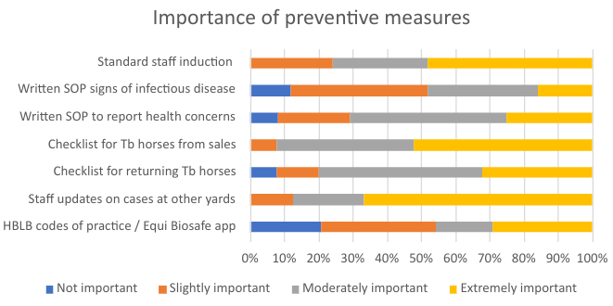
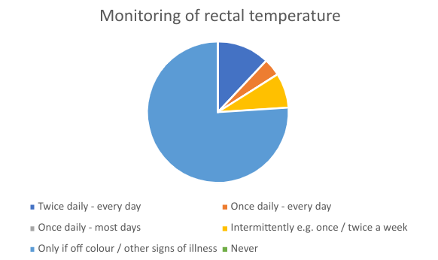
Results – racehorse trainers
Staff awareness of industry level risk was considered important
Checklists were considered a useful tool but were infrequently used
Written SOP infrequently developed
Few used the EquiBiosafe app
24%
4%
8%
76%

Slide 11
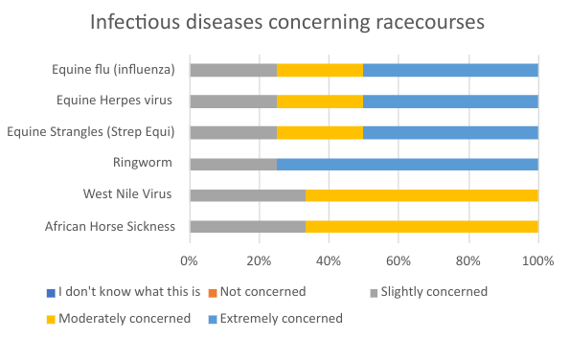
Results - racecourses
57 racecourses contacted
4 completed questionnaire
Response rate 7.0%
Further 4 site visits performed
Feedback that biosecurity complied with due to BHA requirements and that disease in horses are the trainers responsibility
May have been a factor in the low response rates
Ringworm was the most common infectious disease concern

Slide 12
Themes from site visits
Theme 1: Knowledge regarding preventing infectious diseases was acquired through experience
Theme 2: Standards highly complied with were not necessarily formally written down
Theme 3: Best use of resources available

Slide 13
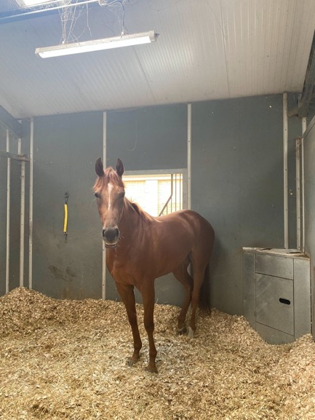
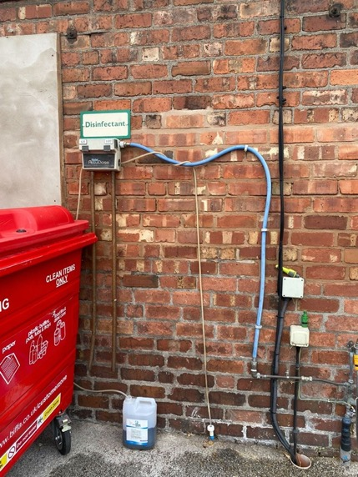
Areas of best practice

Slide 14
Discussion
Raceyards
Trainers anecdotally acknowledged to be a group that are hard to engage with research confirmed by this study
Potential for respondent bias – especially towards those more engaged with biosecurity and concerned about infectious disease / those with more time
Evidence of lack of time, economic pressures and lack of training / use of existing materials such as the Biosafe app
Potential for more formal training? Compulsory?
Racecourses
Already following BHA guidelines and had general good biosecurity measures (set requirements have to be met)
Would be interesting to see what actually happens on a race day to see if there are areas of biosecurity that could be improved

Slide 15
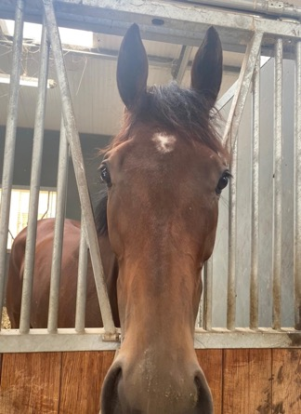
Acknowledgements
This study was funded by the Gerald Leigh Charitable Trust
Thank you to Cathy Duncan, Richard Newton and Katie Byam-Cook who provided advice during study set-up
Thank you to all the trainers and staff on race yards and racecourses who allowed me to undertake site visits

