Slide 1
Genetic diversity and geographic distribution of Theileria equi: Croatia, a European case study. Martine McCann, Summer Project 2021 Supervisor Robert Coultous

Slide 2
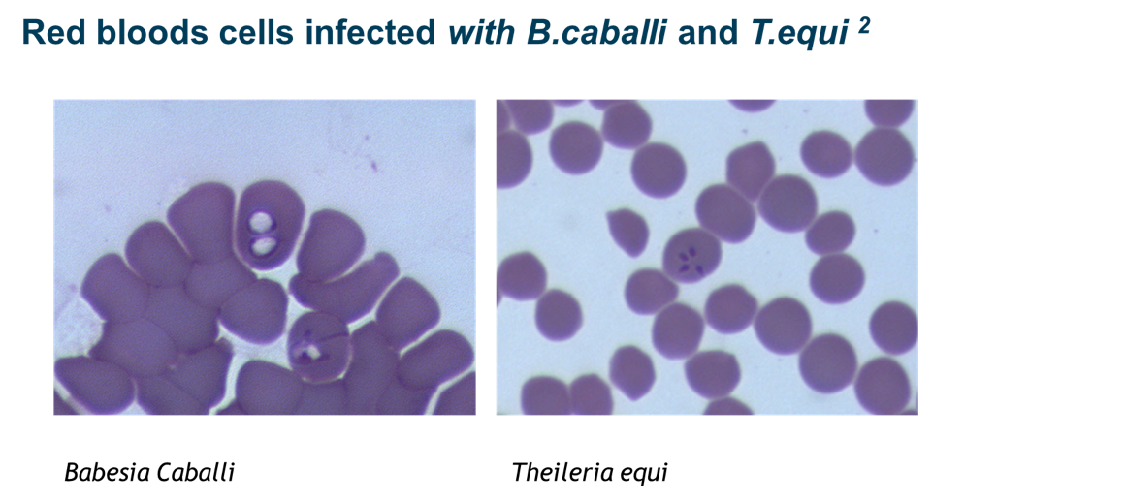
Introduction
Equine piroplasmosis (EP) is a disease affecting equids around the world, caused by the intraerytrocytic protozoan parasites Theileria equi and Babesia caballi ¹.
Transmitted during the feeding of certain tick species, including Dermacentor and Rhipicephalus spp¹.
Occurring with varying degrees of severity, from sub-clinical to life-threatening. In untreated or severe cases death can occur² .
Only 10 % of the global population are living in disease-free areas, notably the UK and Ireland. The OIE ‘High Health, High Performance’ (HHP) scheme considers EP as one of the six equine diseases with a risk of transmission even when the compartmentalisation and biosecurity principles are observed.

Slide 3
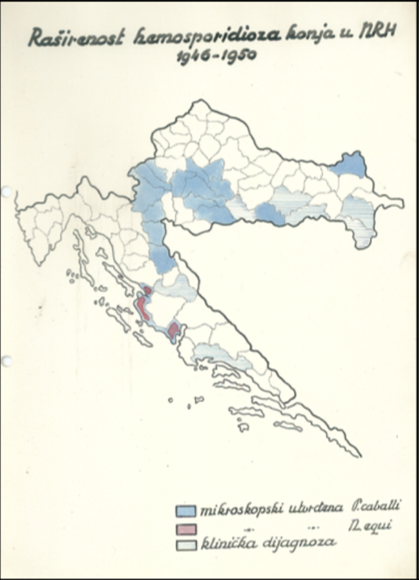
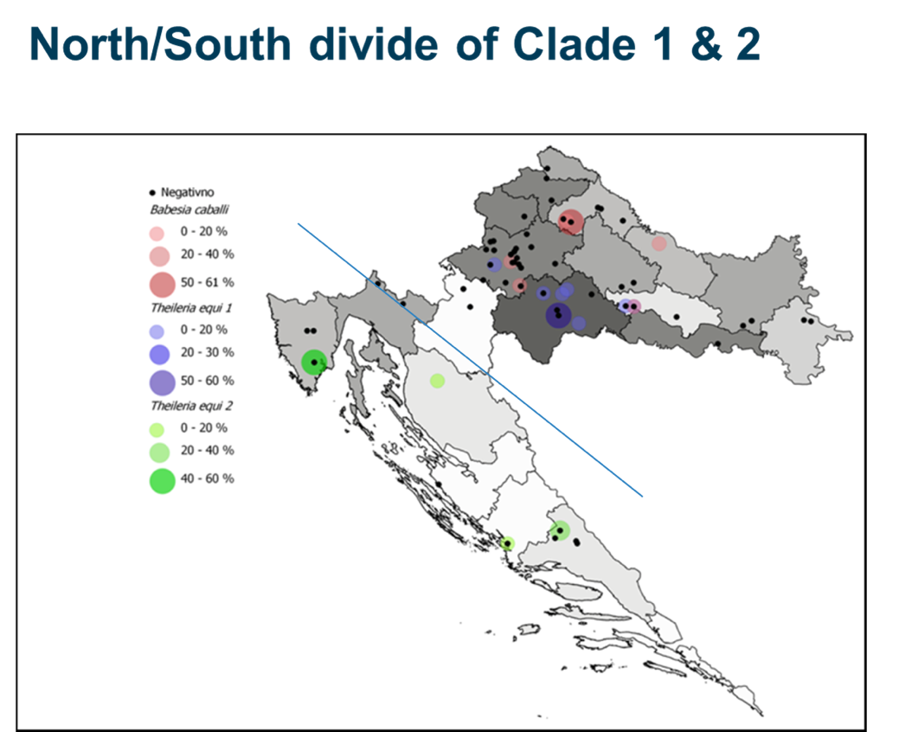
Background
Preliminary analysis of the Croatian samples has strongly suggested a clear north/south geographic divide genetic clade divide based on the 18s rRNA gene.
This is unusual compared to other endemic areas where research shows high degree of genetic diversity, with upto 5 clades described based on 18s rRNA gene. Typically, multiple clades are seen mixing in endemic areas.
Confirmation of this hypothesis would beneficial to current literature as the landscape and its implications for disease has not yet been described in Croatia

Slide 4
Aims Method
Identification of the circulating T. equi genotypes in Croatia, and description of their geographic distribution.
Preliminary work on Croatian samples has initially suggested a distinct geographical north/south divide with one genotype in each area, in contrast to the homogenous mixing of clades in other endemic areas. Further understanding of the genetic diversity of these two groups may help determine the history of introduction of these populations.
Nested PCR screening of 48 Croatian equine blood sample DNA extracts for T. equi equine merozoite antigen (EMA-1) fragments using previously described primers ², with Sanger sequencing of generated amplicons (Eurofins Genomics, Germany).
Creation of phylogenetic trees and statistical analysis of results using relevant software (MEGA X ³).

Slide 5
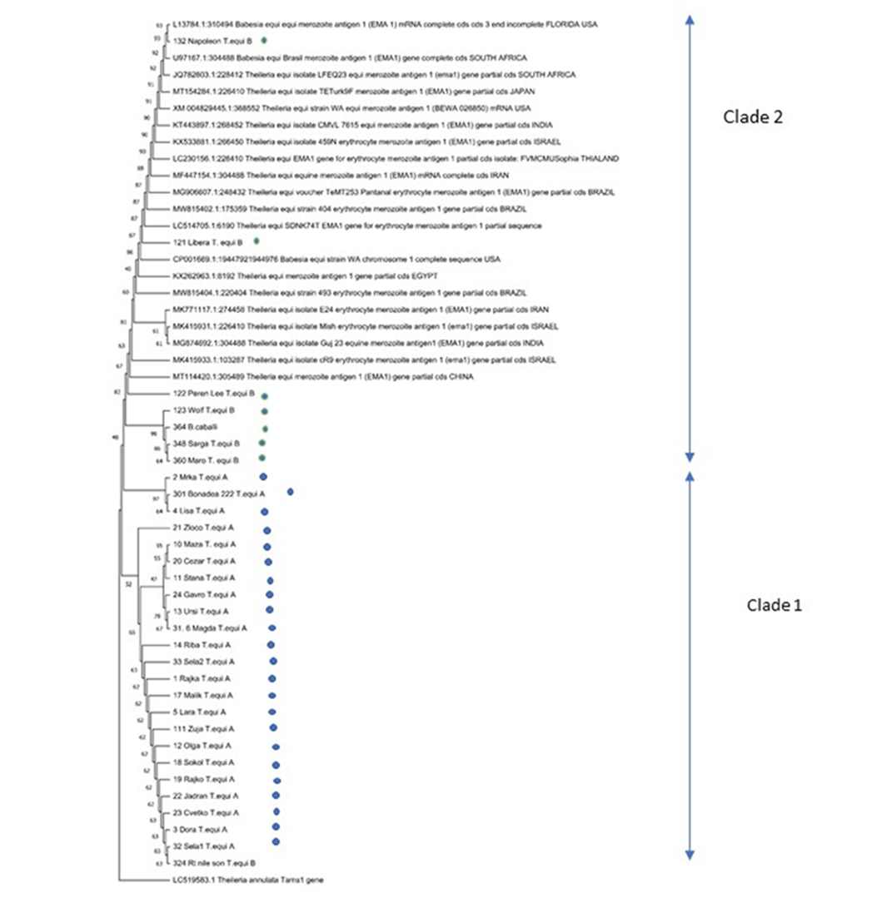
Results
Results
Clade 1 dominates the North of Croatia with a distinct and more conserved genotype, suggesting that it’s been present longer in the area with recombination in this geographically isolated T. equi population leading to a unique sub-group.
Clade 2 is seen to be more diverse and more closely related to genotypes seen from other endemic parts of the world, suggesting a more recent introduction of the piroplasm from these areas, possibly due to the increase of travel of equids.

Slide 6
References
1. Zanet, S., Bassano, M., Trisciuoglio, A., Taricco, I. & Ferroglio, E. 2017, "Horses infected by Piroplasms different from Babesia caballi and Theileria equi: species identification and risk factors analysis in Italy", Veterinary parasitology, vol. 236, pp. 38-41.
2. Coultous, R.M. 2019, Equine piroplasmosis: assessing the threat to the UK and Ireland, University of Glasgow. PhD thesis.
3. Selanec, J. et al 2021. Molecular, serological and clinical pathology comparsion of T. equi & B. caballi infected horses, In press.
4. Sudhir K. et al 2018. MEGA X: Molecular Evolutionary Genetics Analysis across computing platforms. Molecular Biology and Evolution 35:1547-1549

