Slide 1
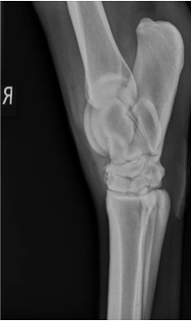
The Characterisation of Equine Synovial Fluid Derived Extracellular Vesicles from Young and Old Horses
Alice Addis, Emily J-Clarke, Mandy Peffers

Slide 2
Equine Osteoarthritis
Lameness due to joint injury and disease is the most prevalent cause of diminished athletic function and wastage
Osteoarthritic changes:
  Degeneration of the articular cartilage
  Changes within the subchondral bone, the synovial membrane and the joint capsule
  Secondary effects to to adjoining connective tissue structures
Alter the joints ability to provide a smooth and nearly frictionless motion as the hose moves
No options for clinical resolution are available

Slide 3
Extracellular Vesicles (EVs)
Nanoparticles enveloped in a phospholipid bilayer membrane
Participate in intracellular communications and are protective carriers for biologically active signalling molecules.
Secreted by most mammalian cells
Act as biomarkers for the progression of disease
How do their characteristics and their cargo change with age?

Slide 4
AIMS of the project
Do EV characteristics change with age?
Mean EV size
Total Evs/ml of sample
D10:D50:D90 ratio
Does EV cargo change with age?
Eca-mir199a-3p
Eca-mir-148a
Eca-mir-146a

Slide 5
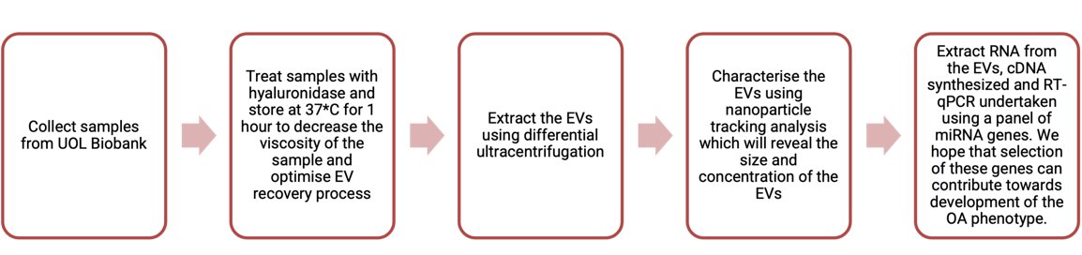
Methods

Slide 6
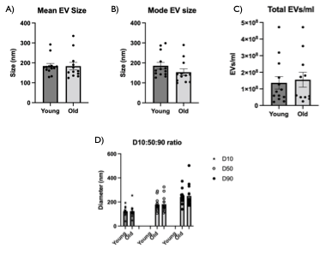
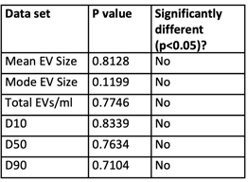
Nanoparticle Tracking Analysis (NTA)
Visualize EVs and provide data on their size and concentration
Properties of light scattering and Brownian motion provide the nanoparticle size distribution of the samples in liquid suspension
Gaussian distribution using a Shapiro-wilk normality test
Identified outliers and removed
Unpaired T-test using GraphPad PRISM (version 9.2.0)

Slide 7
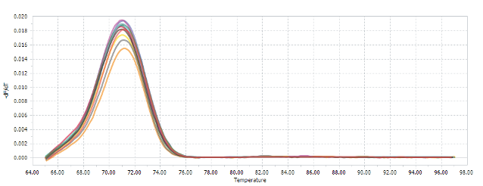
Real time qPCR
RNA extraction
cDNA synthesis
qPCR

Slide 8
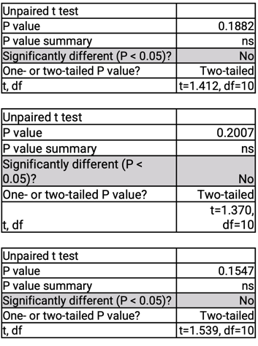
Selection of miRNA primers
Mir148a-3p | Overexpression promotes cartilage production and inhibits cartilage degradation
Mir199a-3p | Evidence of involvement in equine osteoarthritis physiopathology Anabolic and catabolic regulation of key gene expression: MMP13, Adamt-5 or Col2A1
Mir146a-5p | Role in reducing inflammation Chondrogenic differentiation potential

Slide 9
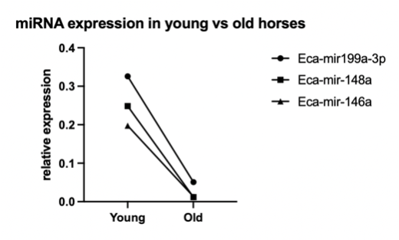
2^-(dCT) to calculate relative gene expression

Slide 10
Mir148a-3p
Ageing and chondrocyte pathway involving the proliferation of cells and tumor lines
Over expression protects cartilage from degradation and promotes its production
Disease modifying compound
OA cartilage shows a decreased expression, as well as changes in cartilage matrix degradation and production

Slide 11
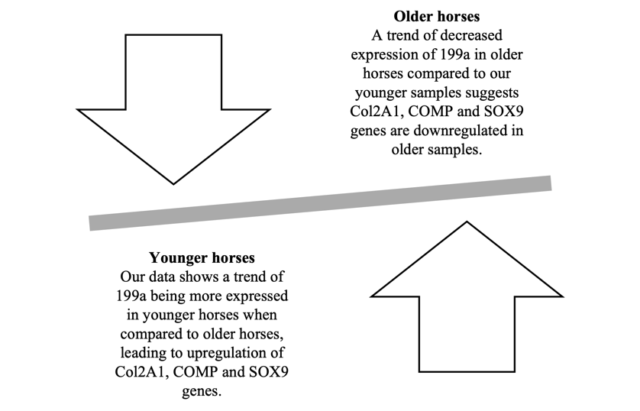
Mir199a-3p

Slide 12
Mir146a-5p
Tumour necrosis, osteoclastogenesis and inflammatory responses
Classed as an inflammRs for its ability to mediate inflammatory pathways
A biomarker of inflammation related to ageing
Arthritic mouse model: IV administration resulted in suppression of bone and cartilage destruction

Slide 13
Conclusion
The size and concentration of EVs were the same when young and old samples were compared
Older horses showed a trend of decreased expression of eca-mir199a-3p, eca-mir-148a, eca-mir-146a
What is the therapeutic potential of these miRNAs?
Could they be used as a biomarker for equine osteoarthritis?

Slide 14
References
Balaskas, P. et al. (2020) 'Small Non-Coding RNAome of Ageing Chondrocytes', International Journal of Molecular Sciences, 21(16), pp. 0-22.
Boere, J. (2017) 'EXTRACELLULAR VESICLES IN SYNOVIAL FLUID: Dynamics during joint inflammation and articular development and promise for joint regeneration and restoration of joint homeostasis', PhD thesis. Utrecht University. Available at: http://dspace.library.uu.nl/handle/1874/355071 (Accessed at 6 January 2022).
Broeckx, SY. et al. (2019) 'The use of equine chondrogenic-induced mesenchymal stem cells as a treatment for osteoarthritis: A randomised, double-blinded, placebo-controlled proof-of-concept study', Equine Vet J, 51(6), pp. 787-794.
Théry, C. et al (2018) 'Minimal information for studies of extracellular vesicles 2018 (MISEV2018): a position statement of the International Society for Extracellular Vesicles and update of the MISEV2014 guidelines', Journal of Extracellular Vesicles, 7(1), pp. 2-47.
Desjardin, C. et al. (2014) 'Next-generation sequencing identifies equine cartilage and subchondral bone miRNAs and suggests their involvement in osteochondrosis physiopathology', BMC Genomics, 15(798), pp. 2-11.
Gibson, G. & Asahara, H. (2013) 'microRNAs and Cartilage', Journal of Orthopaedic Research, 31(9), pp. 1333-1344.
Goldring, S. R. & Goldring, M. B. (2006) 'Clinical aspects, pathology and pathophysiology of osteoarthritis.', Journal of Musculoskeletal and Neuronal Interactions, 6(4), pp. 376-378.
Goodrich, L. R. & Nixon, J. A. (2006) 'Medical treatment of osteoarthritis in the horse – A review'. The Veterinary Journal, 171(3), pp. 51-69.
Malda, J. et al. (2016) 'Extracellular vesicles — new tool for joint repair and regeneration', Nature Reviews Rheumatology, 12(4), pp. 243-249.
McCoy, A. (2016) 'Recent Advances in Equine Osteoarthritis', University of Illinois College of Veterinary Medicine. Unpublished.
Mirza, M. H. et al. (2016) 'Gait changes vary among horses with naturally occurring osteoarthritis following intra-articular administration of autologous platelet-rich plasma', Frontiers in Veterinary Science, 3(29), pp. 1-9.
Neundorf, R. H. et al. (2010) 'Determination of the prevalence and severity of metacarpophalangeal joint osteoarthritis in Thoroughbred racehorses via quantitative macroscopic evaluation', American Journal of Veterinary Research, 71(11), pp. 1284-1293.
Niemelä, T. M., Tulamo, R.-M. & Hielm-Björkman, A. K. (2016) 'A randomised, double-blinded, placebo- controlled clinical study on intra-articular hyaluronan treatment in equine lameness originating from the metacarpophalangeal joint', BMC Veterinary Research, 12(40), pp. 1-8.
'Lameness' (2019) Available at: https://dictionary.cambridge.org/dictionary/english/lameness (Accessed 6 January 2021).
Olivieri, F. et al. (2021) 'miR-21 and miR-146a: The microRNAs of inflammaging and age-related diseases', Ageing Research Reviews, 70(2), pp. 1-19.
Pauley, K. M. & Cha, S. (2011) 'MicroRNA-146a in rheumatoid arthritis: a new therapeutic strategy', Immunotherapy, 3(7), p. 829–831.
Pauley, K. M. et al. (2008) 'Upregulated miR-146a expression in peripheral blood mononuclear cells from rheumatoid arthritis patients', Arthritis Research and Therapy, 10(4), pp. 1-10.
Robbins, P. D. (2017) 'Extracellular vesicles and aging', Stem Cell Investigation, 4(98), pp. 1-7.
United States Department of Agriculture (2000) Lameness and laminitis in U.S. horses. Available at: http://www.aphis.usda.gov/animal_health/nahms/equine/downloads/equine98/Equine98_dr_Lameness.pdf (Accessed: 10 December 2021).
Vonk, L. et al. (2014) 'Overexpression of hsa-miR-148a promotes cartilage production and inhibits cartilage degradation by osteoarthritic chondrocytes', Osteoarthritis and Cartilage, 22(5), pp. 145-153.
Weeren, P. R. v. & Brama, P. A. J. (2001) 'Physiology and pathology of the equine joint', Pferdeheilkunde, 17(4), pp. 307-318.

