Slide 1


Heart rate variability and arrhythmias in Thoroughbred racehorses undergoing treadmill exercise and recovery.
William Sage
contributors: Kate Allen, Melanie Hezzell and Anna Hammond

Slide 2
HEART RATE VARIABILITY (HRV)
Beat-to-beat heart rate variations
    Neurohormonal control
    HR is dynamic
  Time-domain measures offer overall assessment of autonomic function
    SDRR: simplest indicator of R-R variability
    RMSSD: estimate of high-frequency fluctuations
  Frequency-domain measures
    VLF/ULF (very-low/ultra-low): renin-angiotensin-aldosterone system and posture (seconds to minutes)
    LF (low): sympathetic nervous system (seconds)
    HF (high): parasympathetic nervous system on a beat-to-beat basis
  Entropy values
    Measures of irregularity in a biological system

Slide 3
Why?
HRV has been used as a prognostic indicator for cardiac health at rest in humans and horses
There is a growing interest in using HRV for the detection of arrhythmias during exercise
Arrhythmias are commonly observed during exercising Thoroughbreds during treadmill exercise
Can we validate the use of HRV analysis during exercise and find useful associations with clinical conditions, including arrhythmias?

Slide 4
Literature
Physick-Sheard P.W., et. al., (2000) ‘Frequency domain analysis of heart rate variability in horses at rest and during exercise’
Physick-Sheard P.W. and McGurrin M.K. (2010) ‘Ventricular arrhythmias during race recovery in standardbred racehorses and associations with autonomic activity’
Frick L., et. al., (2019) ‘The use of heart rate variability analysis to detect arrhythmias in horses undergoing a standard treadmill exercise test’
Massie S.L., et. al., (2021) ‘Prevalence of cardiac arrhythmias and R-R interval variation in healthy Thoroughbred horses during official Chuckwagon races and recovery’

Slide 5
Objectives
Report HRV indices during submaximal exercise, strenuous exercise and recovery and explore associations with arrhythmia in Thoroughbred (TB) racehorses.
Investigate relationships between HRV indices and other common causes of poor performance in TB racehorses including; lameness, gastric ulceration (EGUS), lower airway inflammation and upper respiratory tract (URTO) obstructions.

Slide 6
Study Design
Clinical records of TB racehorses, which had presented for high-speed treadmill investigation of poor performance between 2007 and 2018 were retrospectively reviewed to facilitate a prospective analysis of associations between HRV, arrhythmias and clinical conditions.
All horses underwent a full clinical examination, including an assignment of a lameness grade, upper airway endoscopy and electrocardiography (ECG) during the treadmill test. Some horses underwent further clinical investigations, including; lower airway evaluations (tracheal endoscopy, tracheal wash (TW), bronchoalveolar lavage (BAL)) and/or gastroscopy.

Slide 7
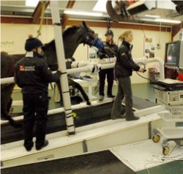
Treadmill exercise test (SIET)
Sub-maximal phase
Strenuous phase
5% incline for 2 minutes at walk (1.8m/s),
1 min at each of 6, 8 and 10 m/s on a 10% incline
Further increments of 1 m/s at 1 min intervals.
4 minutes at trot (3.5m/s)
1 minute at canter (6 or 7 m/s).
Recovery phase
Horses were walked on the treadmill on a 0% incline for 5 minutes
From 2011, a high-speed test (HSET) was introduced for horses in training for flat racing consisting of 1 min at each of 11 and 12m/s on a 10% incline.

Slide 8
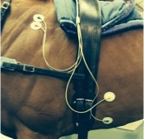
Methods
Self-adhesive electrodes were placed in a modified base-apex configuration
Recordings were obtained and analysed using a telemetric ECG system (Televet 100)
Recordings were corrected manually to ensure correct R wave detection
No ectopic beats or arrhythmias were deleted from the recordings
Text files of the R-R intervals were imported into HRV software (Kubios 3.2)
Results were calculated from the non-detrended R-R series and all Kubios filters were removed

Slide 9
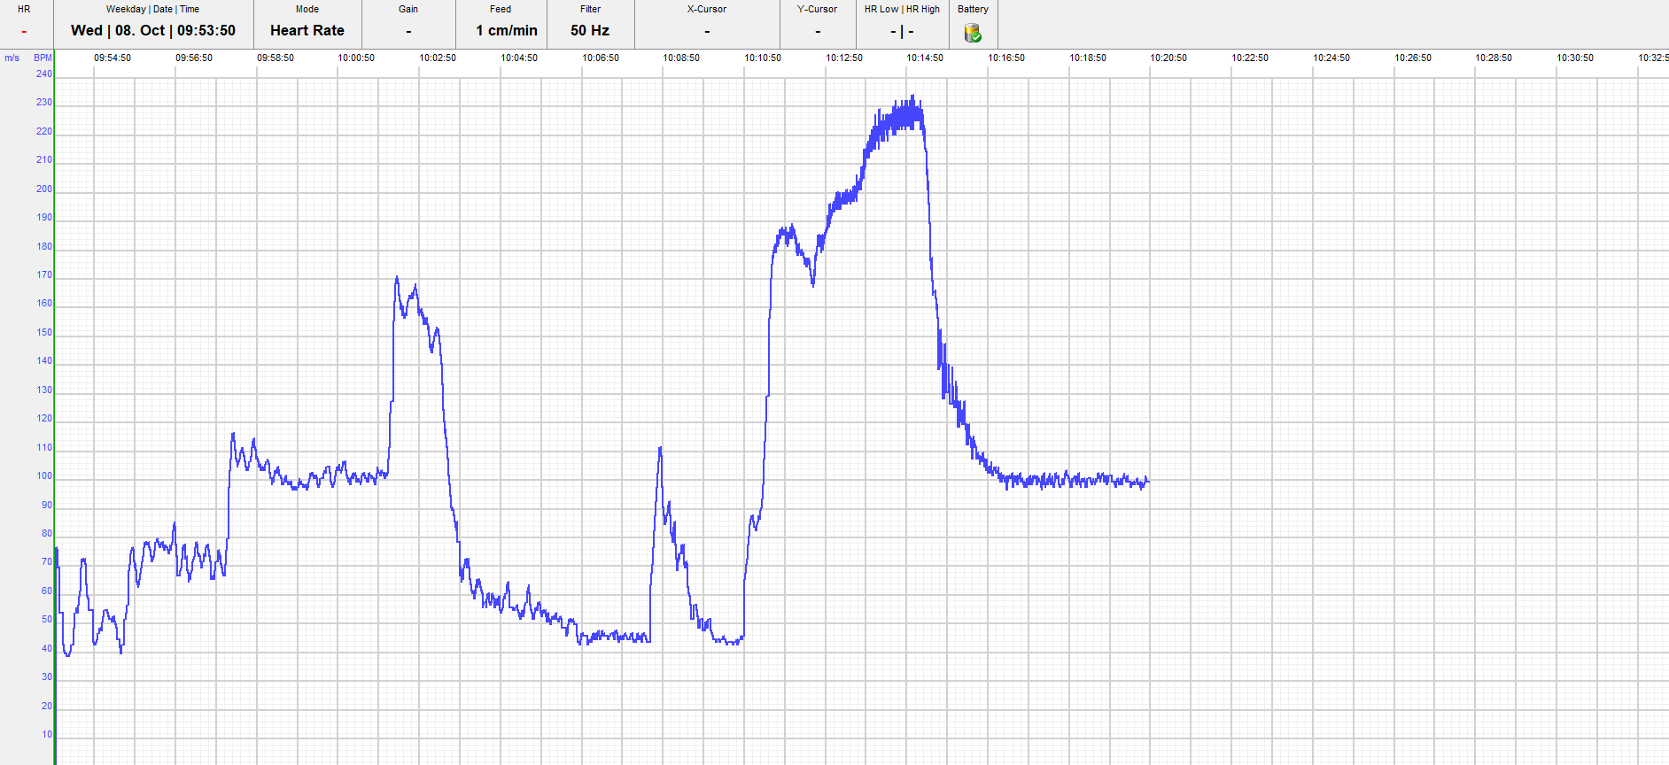
Methods
Submaximal exercise
Strenuous exercise
Recovery phase

Slide 10
Arrhythmia
  Arrhythmias were recorded separately during submaximal exercise, strenuous exercise and recovery
  Horses were categorised into two groups, either with or without arrhythmia
  Horses were assigned to the arrhythmia groups if they had any occurrence of non-sinus rhythm, including:
      supraventricular or ventricular premature depolarisations
      sinus arrhythmia
      atrioventricular block
      paroxysmal atrial fibrillation.
  An 8% cut-off was applied to determine truly premature events, along with visual operator assessment

Slide 11
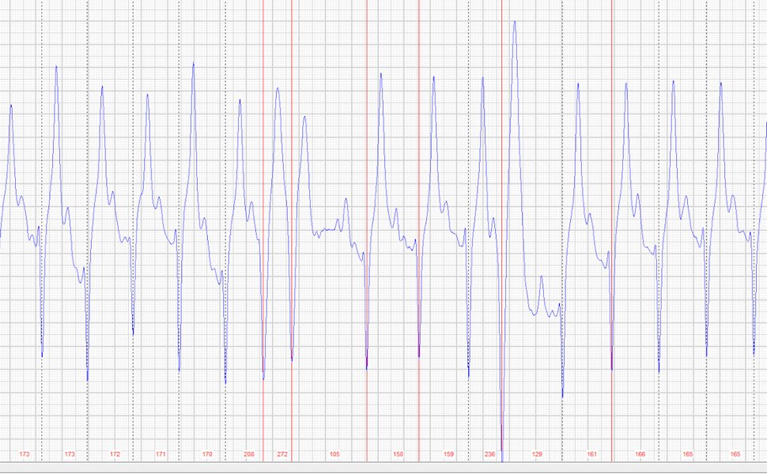
Arrhythmia
SVPD couplet followed by isolated VPD in recovery

Slide 12
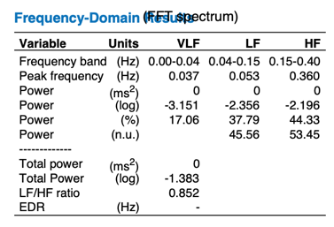
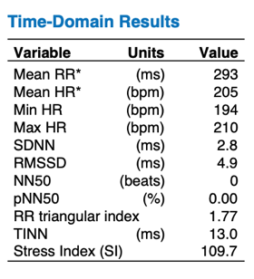
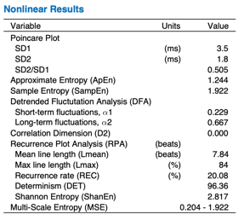
HRV analysis
Kubios:

Slide 13
Statistical analysis
The data were analysed using IBM SPSS
Distribution and variance of the HRV measures were tested for normality using Kolmogorov-Smirnov tests and visual inspection of histograms
Univariate linear regressions were constructed to assess associations between each HRV measure and the clinical variables
Variables associated at the 20% level were then entered into a backwards, stepwise multivariable linear regression model
The residuals were inspected visually to assess for normality and the variables were transformed appropriately when required
Significance was set at P<.05

Slide 14
Results
Variable | Frequency (Yes / No / missing data)
Lameness | 62 / 47 / 71
Upper airway obstruction (URTO) | 128 / 51/ 1
Lower airway inflammation | 74 / 40 / 66
Gastric ulceration (EGUS) | 58 / 26 / 96
High-speed exercise test (HSET) | 12 / 168 / 0
Arrhythmia during submaximal exercise | 10 / 166 / 4
Arrhythmia during strenuous exercise | 71 / 109 / 0
Arrhythmia during recovery | 131 / 49 / 0

Slide 15
Time-domain Results
SDRR in strenuous exercise
RMSSD in strenuous exercise
Variable | B | 95% CI for B | P
Lameness | -.046 | -.129 to .037 | .271
URTO | -.004 | -.074 to .066 | .906
Lower airway inflammation | -.022 | -.099 to .054 | .562
EGUS | .035 | -.058 to .129 | .453
HSET | .071 | -.056 to .198 | .273
Time in strenuous exercise | .000 | .000 to .001 | .353
Arrhythmia during strenuous exercise | .238 | .183 to .293 | <.001
Variable | B | 95% CI for B | P
Lameness | -.043 | -.119 to .033 | .263
URTO | -.004 | -.069 to .061 | .907
Lower airway inflammation | -.009 | -.080 to .063 | .811
EGUS | .033 | -.055 to .121 | .456
HSET | .074 | -.044 to .192 | .215
Time in strenuous exercise | .000 | .000 to .001 | .381
Arrhythmia during strenuous exercise | .221 | .171 to .272 | <.001

Slide 16
Time-domain Results
SDRR in recovery
RMSSD in recovery
(A) Variable | B | 95% CI for B | P
Lameness | .058 | -.093 to .209 | .447
URTO | .090 | -.042 to .222 | .182
Lower airway inflammation | -.042 | -.189 to .105 | .572
EGUS | .009 | -.177 to .194 | .925
HSET | .088 | -.151 to .327 | .469
Time in strenuous exercise | .001 | .000 to .003 | .042
Arrhythmia during recovery | .498 | .386 to .610 | <.001
(B) Variable | B | 95% CI for B | P
Arrhythmia during recovery | .512 | .400 to .624 | <.001
(A) Variable | B | 95% CI for B | P
Lameness | .063 | -.102 to .229 | .455
URTO | .080 | -.065 to .224 | .278
Lower airway inflammation | -.047 | -.207 to .112 | .559
EGUS | .025 | -.172 to .223 | .799
HSET | .048 | -.213 to .309 | .717
Time in strenuous exercise | .002 | .000 to .003 | .013
Arrhythmia during recovery | .614 | .500 to .729 | <.001
(B) Variable | B | 95% CI for B | P
TE | .001 | .000 to .002 | .031
Arrhythmia during recovery | .604 | .490 to .718 | <.001

Slide 17
Frequency-domain Results
VLF in strenuous exercise
HF in recovery phase
(A) Variable | B | CI | P
Lameness | -.204 | -.456 to .048 | .112
URTO | -.176 | -.380 to .028 | .090
Lower airway inflammation | -.000 | -.234 to .234 | >.999
EGUS | -.090 | -.373 to .194 | .530
HSET | -.171 | -.541 to .199 | .363
Time in strenuous exercise | -.001 | -.003 to .002 | .632
Arrhythmia during strenuous exercise | -.278 | -.463 to .093 | .003
(B) Variable | B | CI | P
URTO | -.274 | -.553 to .006 | .055
Arrhythmia during strenuous exercise | -.292 | -.548 to -.036 | .026
(A) Variable | B | CI | P
Lameness | 1.415 | -6.004 to 8.834 | .706
URTO | 1.874 | -4.569 to 8.317 | .567
Lower airway inflammation | 2.175 | -5.402 to 9.751 | .571
EGUS | 2.917 | -6.315 to 12.149 | .531
HSET | -7.087 | -18.661 to 4.487 | .228
Time in strenuous exercise | .093 | .027 to .159 | .006
Arrhythmia during recovery | 11.041 | 4.737 to 17.346 | <.001
(B) Variable | B | CI | P
Time in strenuous exercise | .084 | .019 to .148 | .012
Arrhythmia during recovery | 10.337 | 4.103 to 16.570 | .001

Slide 18
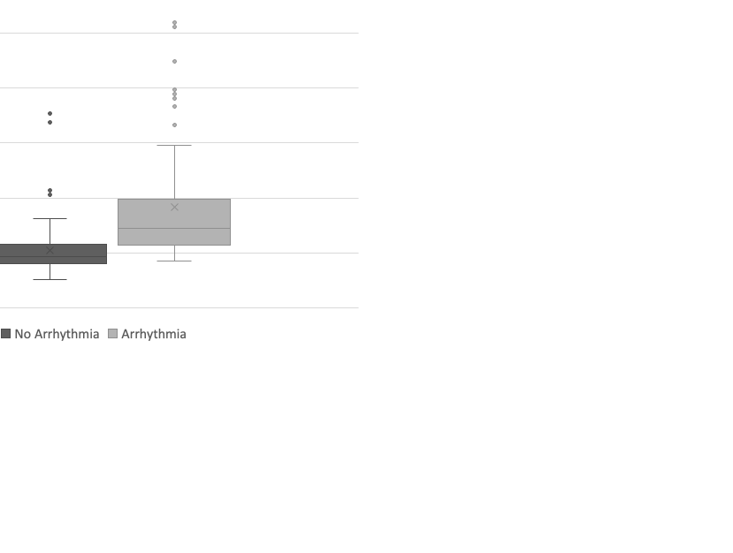
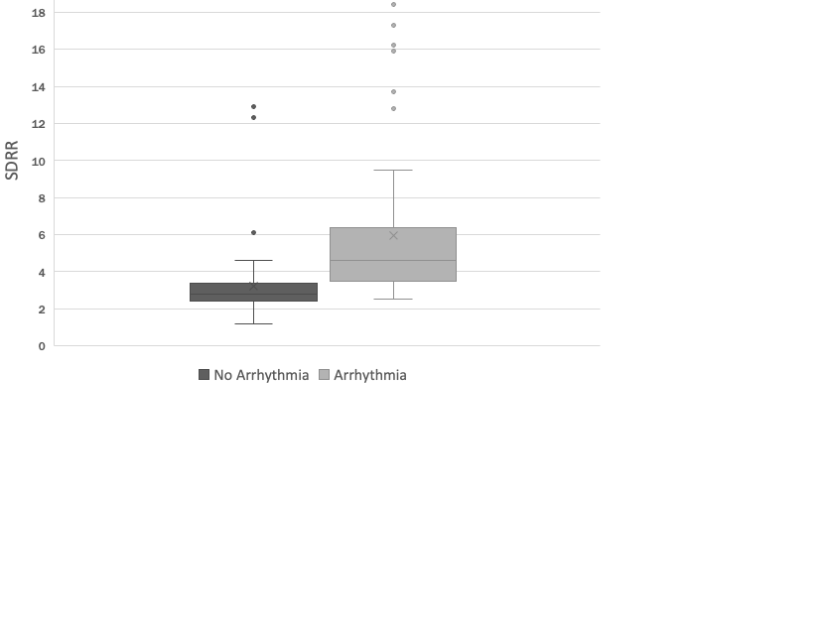
Time-domain Results

Slide 19
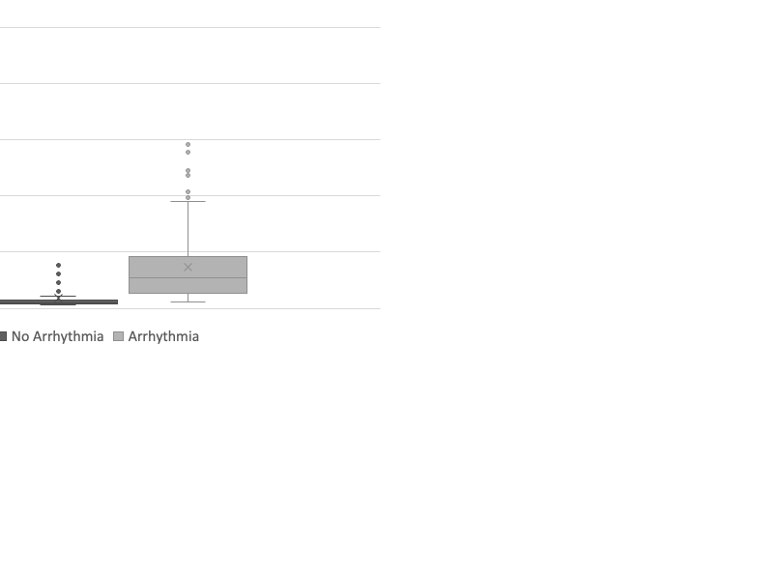
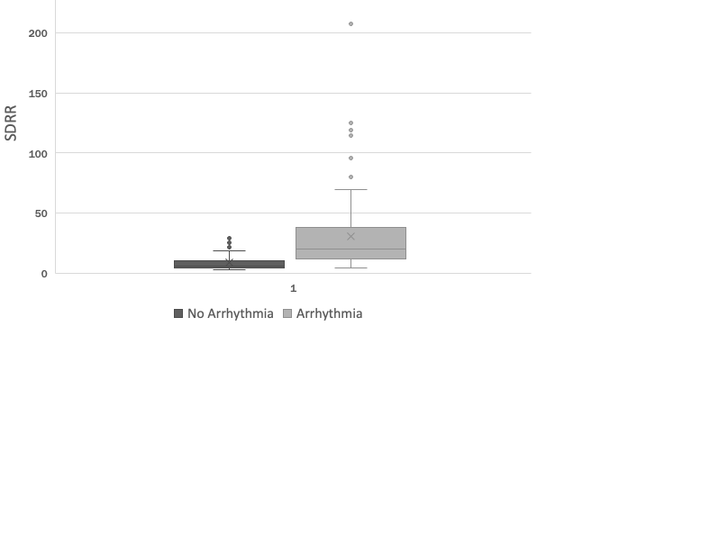
Results

Slide 20
Discussion – Time domain HRV
HRV measures in exercise were lower and within a tighter range than HRV measures in recovery
Arrhythmogenesis was highest in recovery period
All time-domain HRV parameters were increased in horses with arrhythmias (barring log SDRR in submaximal period)
Lame horses had a decreased log RMSSD during submaximal exercise
During recovery, arrhythmia increased all time-domain measures

Slide 21
Discussion – Frequency domain HRV
During submaximal exercise, lower airway inflammation and EGUS influenced frequency domain HRV measures
During strenuous exercise, URTO and EGUS influenced frequency domain HRV measures
During recovery, arrhythmia and time in exercise influenced all frequency domain HRV measures

Slide 22
Limitations
Arrhythmia identification and classification
Cut-off points of clinical conditions for statistical analysis
Spectrum of severity

Slide 23
Conclusions
Arrhythmia influenced HRV measures in all phases of exercise and recovery
And…
Lameness, lower airway inflammation and HSET influenced HRV measures in submaximal exercise
EGUS and URTO influenced HRV measures in strenuous exercise
Time in exercise influenced HRV parameters in recovery phase

Slide 24
References
Allen, K.J., Young, L.E. and Franklin, S.H. (2016) ‘Evaluation of heart rate and rhythm during exercise’, Equine Veterinary Education, 28, pp. 99-112.
Broux, B., De Clercq, D., Decloedt, A., Ven, S., Vera, L., van Steenkiste, G., Mitchell, K., Schwarzwald, C., and van Loon, G. (2017) ‘Heart rate variability parameters in horses distinguish atrial fibrillation from sinus rhythm before and after successful electrical cardioversion’, Equine veterinary journal, 49(6), pp. 723–728.
da Silva, V. P., de Oliveira, N. A., Silveira, H., Mello, R. G., and Deslandes, A. C. (2015) ‘Heart rate variability indexes as a marker of chronic adaptation in athletes: a systematic review’, Annals of Noninvasive Electrocardiology , The Official Journal of the International Society for Holter and Noninvasive Electrocardiology, 20 (2), pp. 108–118.
Frick, L., Schwarzwald, C.C. and Mitchell, K.J. (2019) ‘The use of heart rate variability analysis to detect arrhythmias in horses undergoing a standard treadmill exercise test’, Journal of Veterinary Internal Medicine 33, pp. 212-224.
Gąsior, J. S., Hoffmann, B., Silva, L., Małek, Ł., Flatt, A. A., Baranowski, R. and Werner, B. (2020) ‘Changes in Short-Term and Ultra-Short Term Heart Rate, Respiratory Rate, and Time-Domain Heart Rate Variability Parameters during Sympathetic Nervous System Activity Stimulation in Elite Modern Pentathlonists - A Pilot Study’, Diagnostics, 10 (12), p. 1104.
Marr, C.M., Franklin, S., Garrod, G., Wylie, C., Smith, L., Dukes-McEwan, J., Bright, J. and Allen, K. (2020) ‘Exercise-associated rhythm disturbances in poorly performing Thoroughbreds: risk factors and association with racing performance’, Equine Veterinary Journal, 53, pp. 656-669.
Massie, S.L., Bezugley, R.J., McDonald, K.J., Leguillette, R. (2021) ‘Prevalence of cardiac arrhythmias and R-R interval variation in healthy Thoroughbred horses during official Chuckwagon races and recovery’, The Veterinary Journal, 267, pp. 1090-0233.

Slide 25
References continued
Michael S., Graham K.S., Davis G.M. OAM. (2017) ‘Cardiac Autonomic Responses during Exercise and Post-exercise Recovery Using Heart Rate Variability and Systolic Time Intervals—A Review’. Frontiers in Physiology. 29, pp. 8-301.
Physick-Sheard P.W. and McGurrin M.,K. (2010) ‘Ventricular arrhythmias during race recovery in standardbred racehorses and associations with autonomic activity’. Journal of Veterinary Internal Medicine, 24, pp. 1158–66.
Physick-Sheard P.W., Marlin D.J., Thornhill R. and Schroter R.C. (2000) ‘Frequency domain analysis of heart rate variability in horses at rest and during exercise’, Equine Veterinary Journal, 32(3), pp. 253-62.
Ryan N., Marr C.M. and McGladdery A.J. (2005) ‘Survey of cardiac arrhythmias during submaximal and maximal exercise in thoroughbred racehorses’, Equine Veterinary Journal, 37, pp. 265–8.
Schmidt A., Biau S., Möstl E., Becker-Birck M., Morillon B., Aurich J., Faure J.M. and Aurich C. (2010) ‘Changes in cortisol release and heart rate variability in sport horses during long-distance road transport’, Domestic Animal Endocrinology, 38(3), pp. 179-89.
Shaffer F. and Ginsberg J.P. (2017) ‘An Overview of Heart Rate Variability Metrics and Norms’, Frontiers in Public Health, 5, p. 258.
Slack, J., Stefanovski, D., Madsen, T.F., Fjordbakk, C.T., Strand, E. and Fintl, C. (2021) ‘Cardiac arrhythmias in poorly performing Standardbred and Norwegian–Swedish Coldblooded trotters undergoing high-speed treadmill testing’, The Veterinary Journal, 267.
Vitale, V., Viu, J., Armengou, L., Ríos, J. and Jose-Cunilleras, E. (2020) ‘Prognostic value of measuring heart rate variability at the time of hospital admission in horses with colic’, American journal of veterinary research, 81(2), pp. 147–152.

Slide 26
Thank you for listening
Any questions?

